Slide 1
A radon-only technique for quantifying the effects of atmospheric stability on air pollution concentrations
Scott Chambers, Alastair Williams, Jagoda Crawford and Alan Griffiths
ANSTO Institute for Environmental Research, Sydney, NSW, Australia
International Symposium on ‘Management of Environmental Quality and Pollution Control’
21 January 2015
Hosted by Brain Korea (BK) 21 Plus Program, Hanyang University
Supported by Korean Society of Atmospheric Environment

Slide 2
Urban pollution research – “non-negotiables”
Accurate observations: to assess exposure, risks, and the efficacy of emission mitigation strategies.
Requires the ability to quantify episodic concentrations, relative to changing reference (background) values
Reliable modelling: to forecast future risks and assist with planning.
Requires the ability to accurately predict contemporary and future ranges of pollutant concentrations for different atmospheric states
To achieve these goals we require a better understanding of factors contributing to variability in pollutant concentrations
Near surface pollutant concentrations mainly governed by three things:
source strengths (spatial/temporal)
sink mechanisms (including chemical transformations)
atmospheric characteristics (e.g. mixing volume, mixing state, entrainment etc.)
Notes:
The ‘non-negotiable’ requirements
Long lived gases accumulate in the atmosphere – thus baseline concentrations change

Slide 3
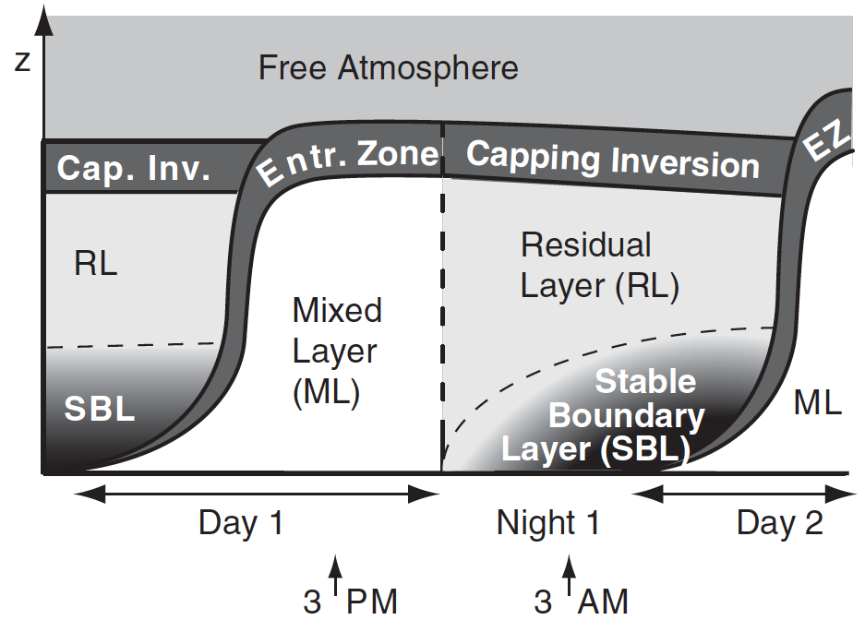
Atmospheric mixing
Atmospheric mixing depth changes diurnally
Deepest during the day (convective and mechanical mixing)
Shallowest at night (mechanical mixing and thermal stratification)
For urban emissions, mixing depth is one of the largest influences on near-surface concentrations (e.g. “haze” under a morning inversion)
At night “mixing depth” and “stability” often used interchangeably
Many conventional measures of atmospheric stability:
Research-grade observations: Richardson number, Obukhov Length
Standard climate observations: Pasquil-Gifford schemes (turbulence/radiation)
But the concentrations of passive tracers (e.g. ²²²Rn) are more closely matched with pollutant transport and mixing processes at the surface
Notes:
Ri / L stability measures are based on the values of, or ratios between, the near-surface temperature and wind speed gradients or their turbulent flux counterparts

Slide 4
Radon: a powerful atmospheric tracer
Radon-222 is the only gas in the Uranium-238 decay chain
Radon comes from most land surfaces (unsaturated / unfrozen)
Surface-only source; almost exclusively from land (not water)
Source function changes little in space & time
Unreactive / poorly soluble: sole atmospheric sink is radioactive decay
Short half-life (3.8d) → (a) doesn’t accumulate in the atmosphere
(b) large ABL / troposphere gradient
Rn half-life >> mixing timescale of the ABL (1-hour)
Over 1 night (10-12h) Rn is an approximately conservative (>90%) tracer
Notes:
Compared to other available atmospheric tracers radon is particularly versatile and powerful with very simple source / sink characteristics
Unlike CO2, CH4, CFCs etc., radon does not accumulate in the atmosphere on greater than synoptic timescales

Slide 5
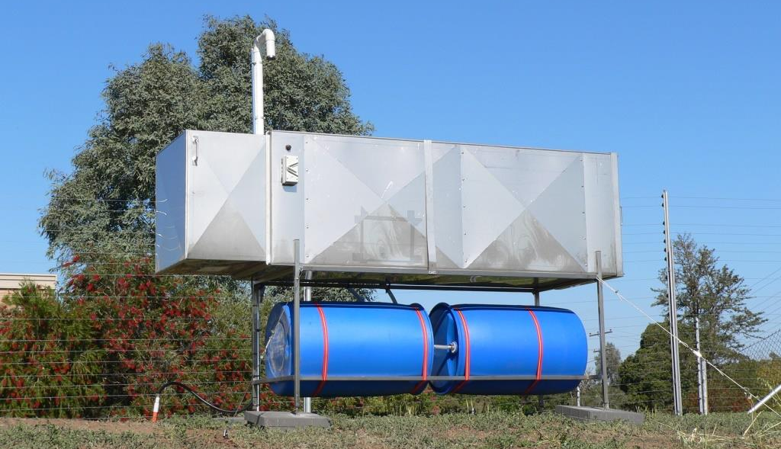
ANSTO environmental radon detectors
ANSTO design, build & operate dual-flow-loop two-filter radon detectors
Long-term, continuous, hourly, radon observations (direct – not by progeny)
Response time ~45 minutes
Lower limit of determination (1500 L model) 20 mBq m⁻³
1500 L Detector
Available models
100 L
700 L
1500 L
5000 L
Sensitivity changes with volume
200 → 10 mBq m⁻³
Notes:
Direct (not by progeny) radon measurements means that no assumptions need to be made regarding the state of equilibrium between ambient radon and its progeny (this equilibrium can change with proximity to the surface, surface characteristics, and weather conditions)

Slide 6
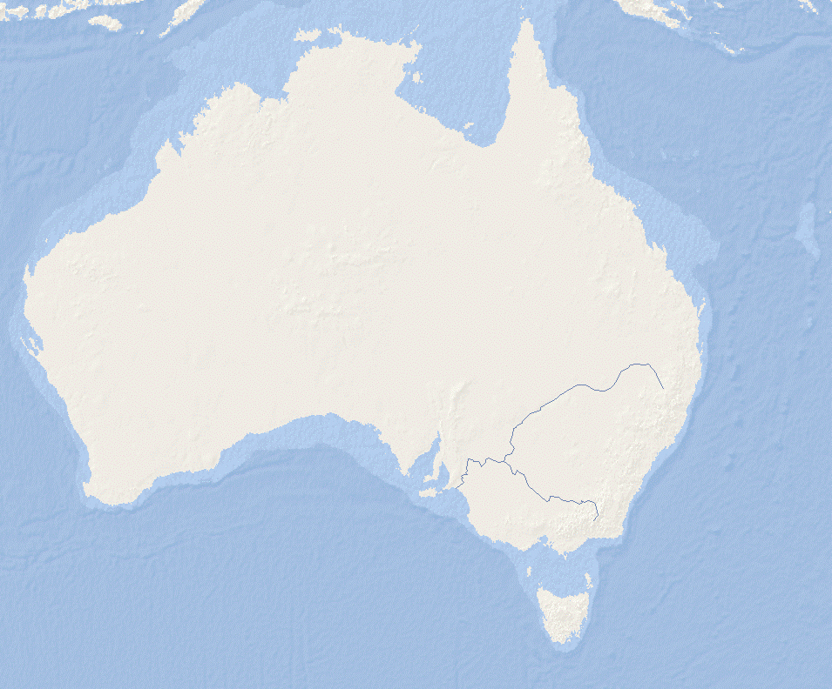
1-year, hourly radon time series
Sydney
Variability on many time scales
Seasonal (1-6 months)
Synoptic (1-10 days)
Diurnal (24 hours)
Sub-Diurnal
Fetch, mixing and non-local processes
Seasonal Rn variability – fetch related
Winter
Offshore
Flow
Summer
Onshore
Flow
Winter
Summer

Slide 7
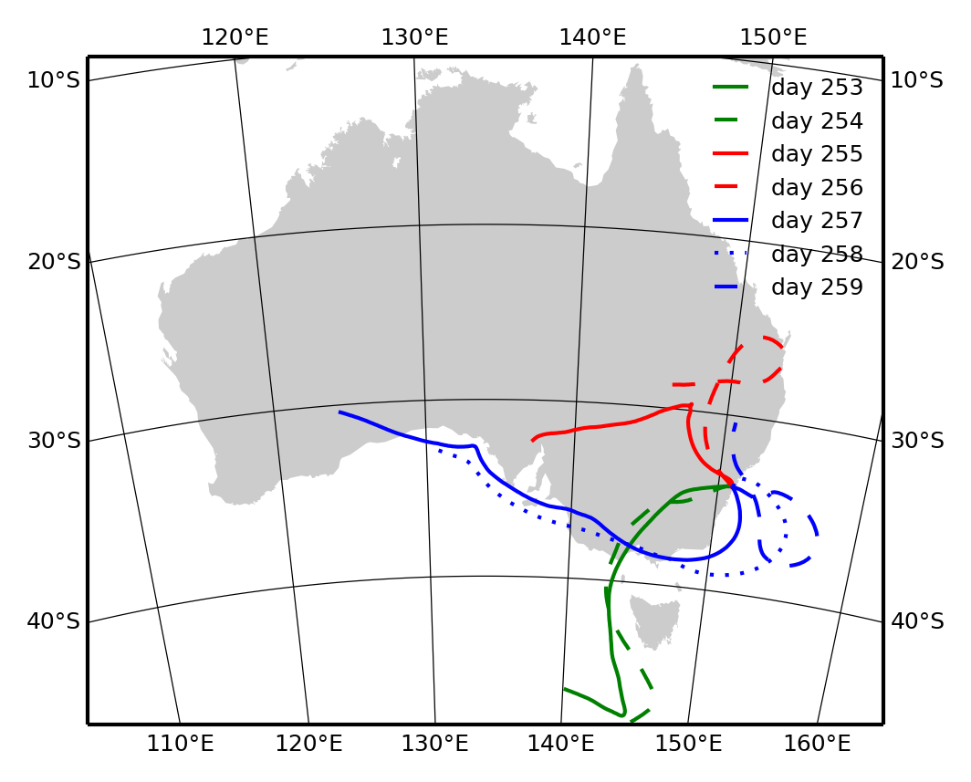
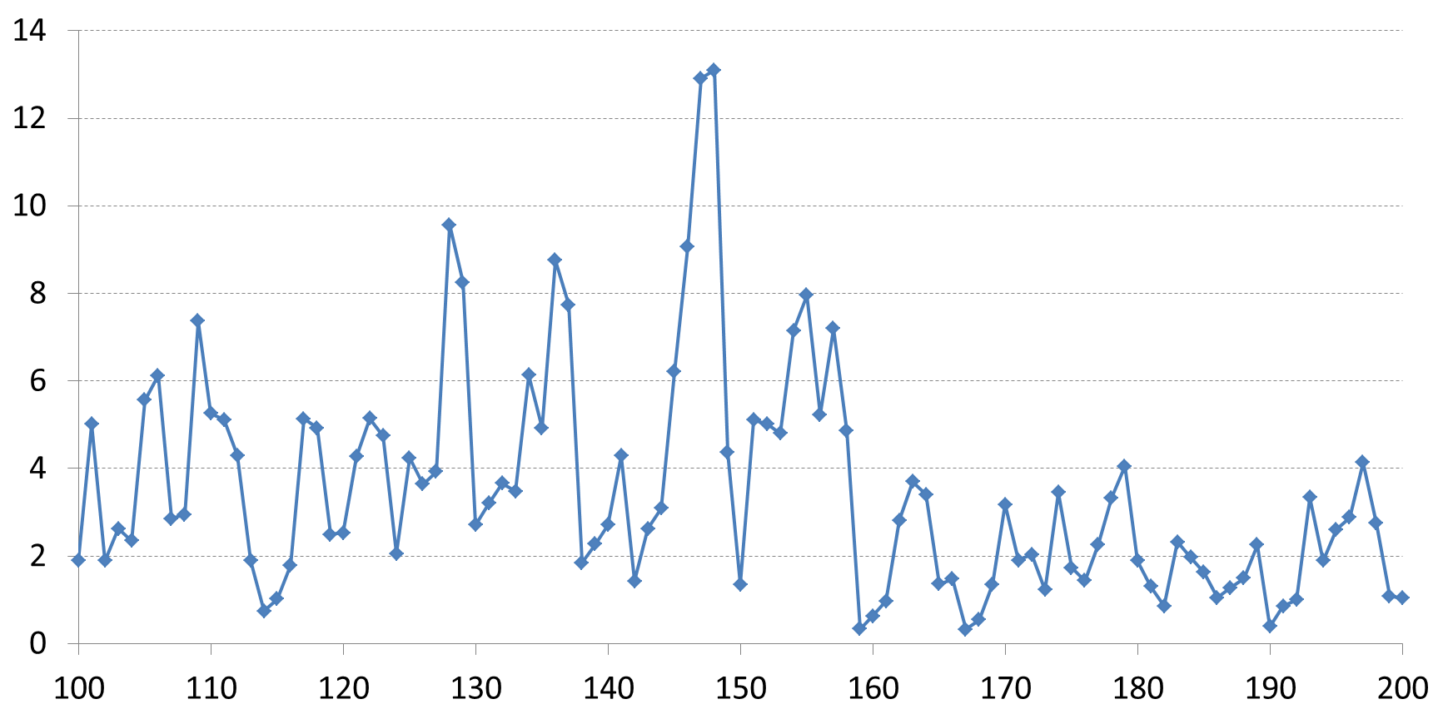
Synoptic radon variability – fetch related
Fetch changes off-shore to
on-shore with the passage of synoptic systems
L
H
Daily mean radon
1-week in Spring
Time-scale 1-10 days

Slide 8
Diurnal radon variability – mixing related
Radon has recently been called a good “stability indicator” (e.g. OPSIS SM200)
But before we can use radon as a stability indicator we need to separate the fetch-related and mixing-related (diurnal) signals
Notes:
Diurnal variability does not relate as much to where the air mass has been (fetch), more to changes in mixing depth.
Only the local diurnal changes in radon concentration resulting from changes in mixing depth are related to atmospheric stability – variability of radon due to all other processes needs to be removed before further analysis
When using radon gradient observations, this removal / isolation of non-diurnal influences is automatic

Slide 9
Separating the radon signals
Radon half-life 3.8 days
2 weeks ~4 half lives (<10%)
Afternoon radon concentrations reflect the air mass fetch history (~2-weeks)
Each night accumulation in NBL adds to ambient (advected) radon
Amplitude of the difference between these signals relates to mixing depth
Difference (“gradient”): Observed - Advected
Notes:
Mention that the difference here is a “pseudo gradient”

Slide 10
Radon “pseudo gradient”
Interpolate between afternoon values for “fetch” signal
Gradient
observed – fetch
relates to mixing depth (stability)

Slide 11
“Pseudo gradient” – diurnal composite
Since radon has a uniform surface source and is ~conservative over 1 night:
Total accumulated radon directly relates to average nocturnal stability (mixing depth)
Accumulation window
Calculate the accumulation for each day and devise a stability classification scheme.
Convective mixing off
Convective mixing on

Slide 12
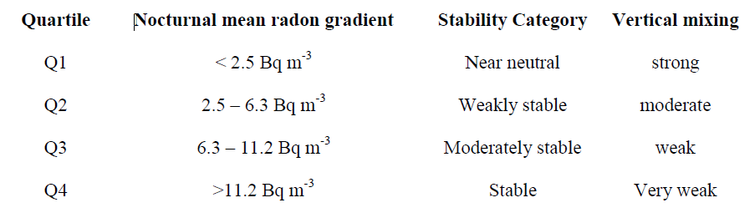
Radon-based stability classification
Average accumulated radon
(5-years, daily)
Stability category diurnal composite radon
Notes:
Here we arbitrarily define 4 categories – could be more or less depending on data availability (technique completely transferable to any site that is removed from sharp gradients in radon flux)
Categories pertain to the mean atmospheric stability state over the 10-12 hour accumulation period
Different stability classifications may be required for different seasons if snow/ice changes the radon flux
The width of the accumulation window can be changed to accommodate seasonal changes in daylight hours – and the accumulated radon concentrations can be referenced to the starting value (i.e. just after sunset)
Although the categories are only defined for a 10-12 hour period, atmospheric “persistence” usually (more than 70% of the time) means that the classifications can be applied to whole days

Slide 13
Analysing meteorology
by radon-based stability category
Stable: low nocturnal wind speed, high wind direction variability, large temperature amplitude
Near-neutral: higher, more consistent, wind speed & direction, lower amplitude temp fluctuation

Slide 14
Analysing urban pollutants
by radon-based stability category
Stable: large amplitude changes
Near-neutral: small amplitude changes
Different diurnal cycles to radon reflect spatial / temporal source / sink variability
NO / PM_{2.5} morning peak exaggerated cf. evening peak since primary emissions are entering shallow SNBL
Nocturnal O₃ source is RL (broad & consistent) ~inversion of Rn shape
Completely independent of site meteorology

Slide 15
Comparison with Pasquil-Gifford stability typing:
(a) Turbulence scheme
Categorisation based on standard deviation of wind direction, and mean wind speed
Nocturnal categories: D - neutral, E - moderately stable, F - stable
PG-T
PG-T
Distinction between categories less clear.
Peak concentrations under stable conditions underestimated
Radon

Slide 16
Comparison with Pasquil-Gifford stability typing:
(b) Radiation scheme
Categorisation based on cloud cover, solar elevation and mean wind speed
Nocturnal categories: D - neutral, E - moderately stable, F - stable
Lanzhou, central China (2008)
Radon scheme
PG-Radiation scheme
Distinction between categories less clear.
Peak concentrations under stable conditions underestimated
Radon method yields more uniform distribution of events between categories (~25% each)
(PG-R: <10% neutral, >50% stable)

Slide 17
Influence of stability on nocturnal mixing depth
The change in radon (C) in the NBL is a balance between
flux (F), decay (λ) and dilution (D).
Iterative solution for h: equivalent mixing depth (h_{e})
Analytical solution for h: accumulated mixing height (h_{acc})
Notes:
Assumed radon flux in this case was 20 mBq m⁻² s⁻¹

Slide 18
Conclusions
Radon is a powerful and comparatively economical tool for atmospheric stability analysis of urban pollution
Radon can also be used to evaluate model performance
Radon can also be used to identify baseline/reference air
Characterising pollution by radon-derived stability category is ideal for evaluating:
(1) the efficacy of emission mitigation strategies, and
(2) improvements to chemical transport models
Notes:
Model performance is generally poorest under stable conditions, when nocturnal mixing depths are shallow, and there is decoupling between the near-surface air and the overlying residual layer. Using this method it is possible to target, and selectively evaluate, model performance for different stability regimes

Slide 19

Thank you

