Slide 1


Unique capabilities and methods for analysing nuclear waste form materials using ANSTO’s landmark infrastructure
Gabriel L. Murphy^{a,b}, Zhaoming Zhang^{b}, Maxim Avdeev^{b}, Bernt Johannessen^{c}, Helen Maynard-Casely^{b} Helen Brand^{c} and Brendan J. Kennedyª.
ªSchool of Chemistry, University of Sydney, New South Wales, Australia, ^{b}Australian Nuclear Science and Technology Organisation, Lucas Heights, New South Wales, Australia, ^{c}Australian Synchrotron, Clayton, Victoria, Australia,
Email: gabriel@ansto.gov.au
Notes:
Thank you chair. So if you were to read my profile on the lovely conference app, you would see my research is focussed strongly at examining thorium and uranium materials potentially relevant to waste forms extensively using neutron and synchrotron x-ray scattering courtesy of ANSTO. For lots of other nuclear science researchers it is painfully apparent that attempting to move active samples to a synchrotron or neutron facility is highly challenging and arduous. This often becomes a bridge too far, with many sticking to in house characterisation methods which often lack the sensitivity and resolution capable of divulging significant and useful scientific data. You only have to look at the great PDF talks in yesterday afternoons session to see what can be ascertained when using neutron and synchrotron sources. I chose with my talk that instead of giving a singular focused study I would give a variety of broad studies. This is not to show off and gloat ansto but rather demonstrate what can be achieved when perseverance, communication and safety are correctly executed towards transport and analysing nuclear materials on neutron and synchrotron x-ray sources in terms of uncovering the unique properties and phenomena the actinides can exhibit. Furthermore, being an actinide researcher with a focus on fundamentals I want to show you both the importance and insight that can be gained from executing, often critised in the nuclear sphere, fundamental studies.

Slide 2
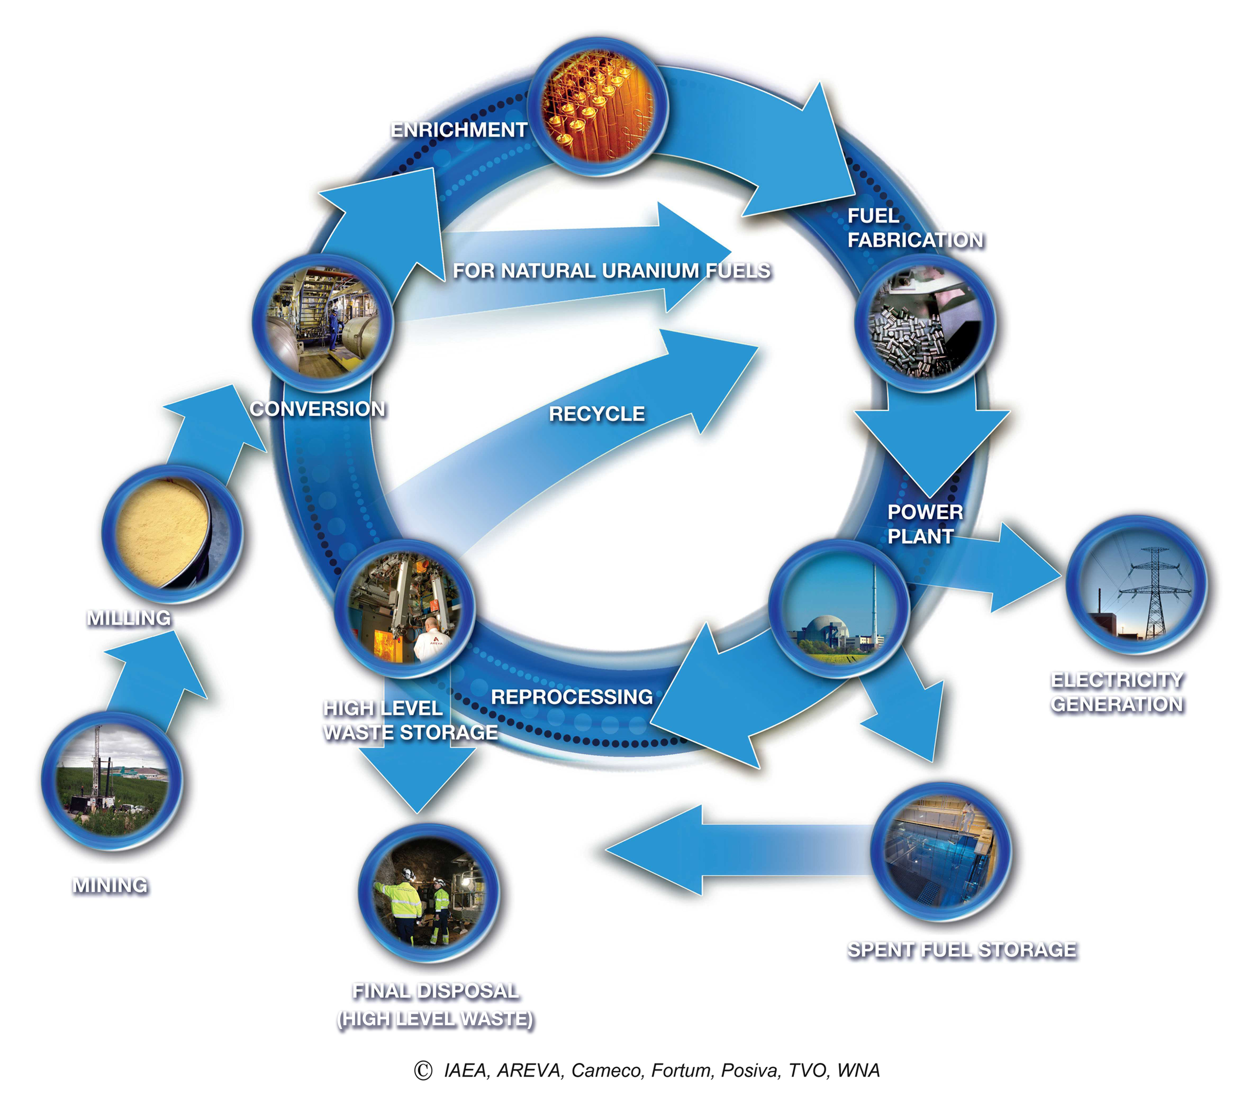
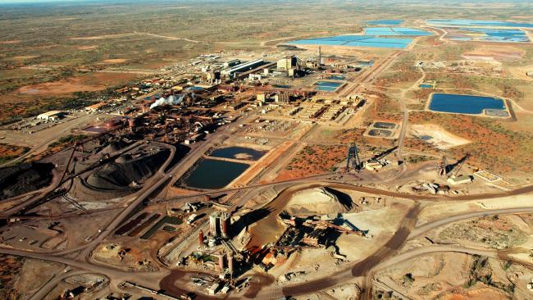
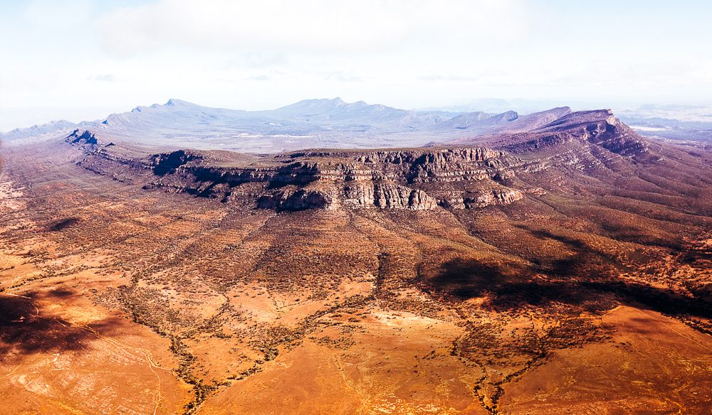
Australia and the NFC
Olympic Dam BHP uranium-copper mine South Australia
Flinders Ranges – Nuclear Waste Storage Region Candidate
IAEA, AREVA, Cameco, Fortum, Posivam TVO, WNA Report
http://cdn.newsapi.com.au/image/v1/566a7daeeb54b060e3f2a07ccd6ce820?width=650
https://s1.at.atcdn.net/wp-content/uploads/2015/02/0D8A0038_2.jpg.
2
Notes:
Australia and the NFC, as has been outlined, particularly by the talks earlier this week australias involvement in the NFC is relatively confined to the front of the cycle but also towards the back end regarding waste immobilisation.

Slide 3

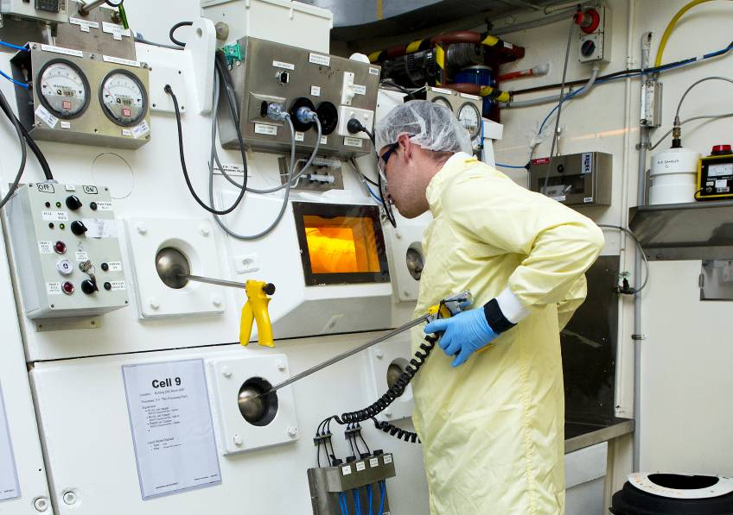
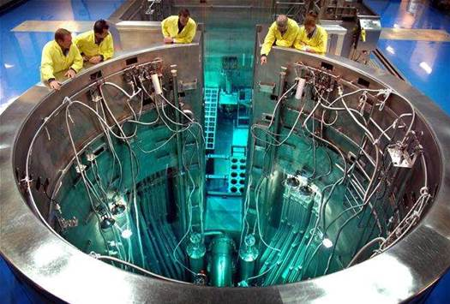
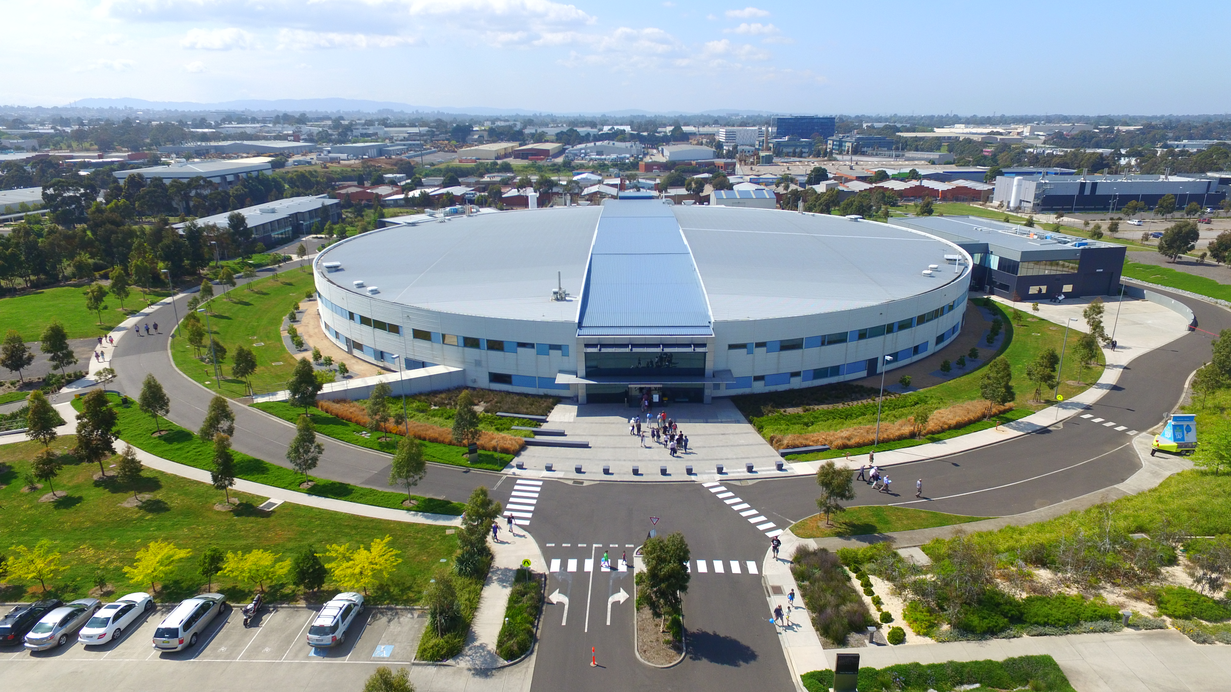
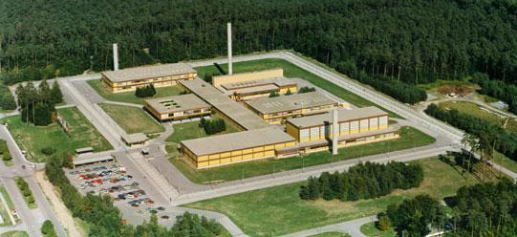
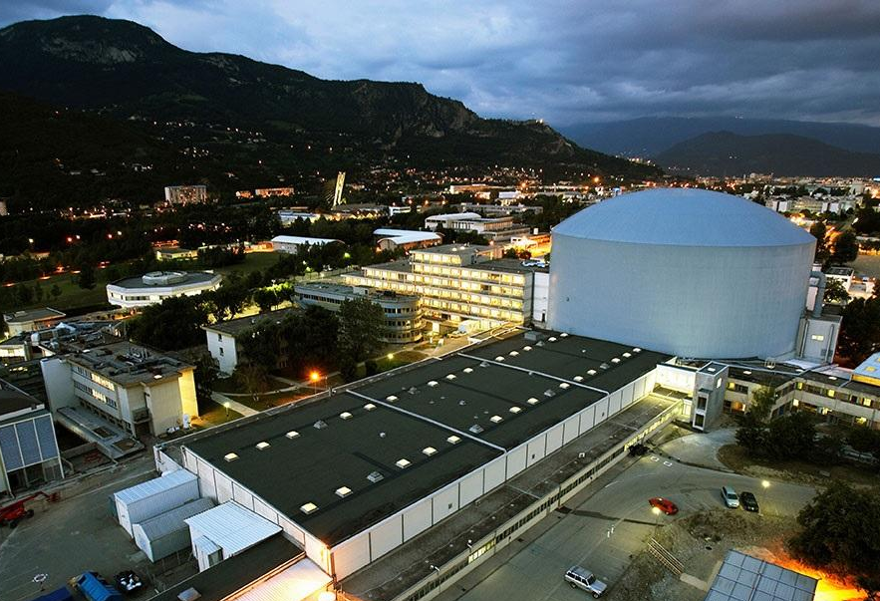
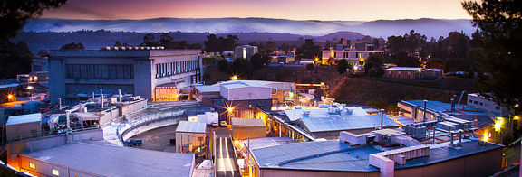
ANSTO’s
Landmark Infrastructure
Active handling laboratories and facilities
20 MW Light Water Research Reactor Neutron Source
3rd Generation 3 GeV Synchrotron Light Source
Former Institute for Transuranium elements now JRC Karlruhe, Germany.
Institut Laue-Langevin, France.
Stanford Synchrotron Radiation Light Source, United States.
http://nnimgt-a.akamaihd.net/transform/v1/crop/frm/GfJngK5YTXYCX6hRspWazz/66e8ebbe-934c-499d-bdde-8d49bbde3869.jpg/r0_833_3459_3597_w1200_h678_fmax.jpg
http://i.nextmedia.com.au/Utils/ImageResizer.ashx?n=http%3A%2F%2Fi.nextmedia.com.au%2FNews%2Fopal-2-large-20110926202101-resized_20130531100212.jpg&w=525&c=0&s=1
https://industry.gov.au/AboutUs/CorporatePublications/AnnualReports/AnnualReport201415/sites/prod.ar2015/files/images/The%20Australian%20Synchrotron%20from%20above%20on%20the%202015%20Open%20Day.JPG
3
Notes:
So if you don’t already know, ansto in my opinion is extremely well equipped to research nuclear materials with on site access to active handling facilities , the OPAL nuclear reactor and neutron source with also now the australian synchrotron joining this suite of facilities. From my self and my colleagues opinions, ansto is probably the best equipped facility internationally in these facets. A few examples are here of other global facilities with international reputations but these do not have the triality of activeH, reactor and synchrotron sources. The conservative pessimsists in the audience might say, well why do you need them?! Now instead of using some kind of hypothesized partially anecdotal example and how they could be applied, I want to instead draw your attention to an extremely successful case study of when they were. The rocky mountains flats

Slide 4
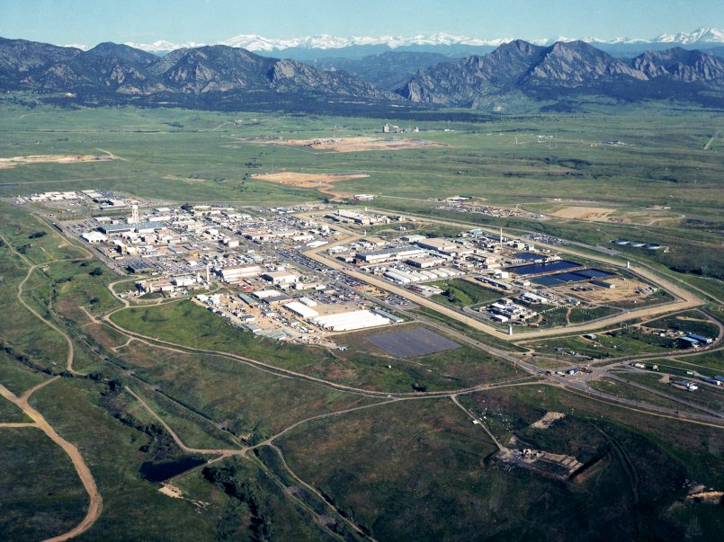
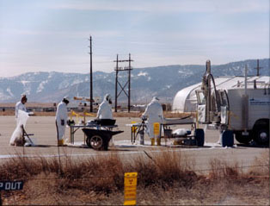
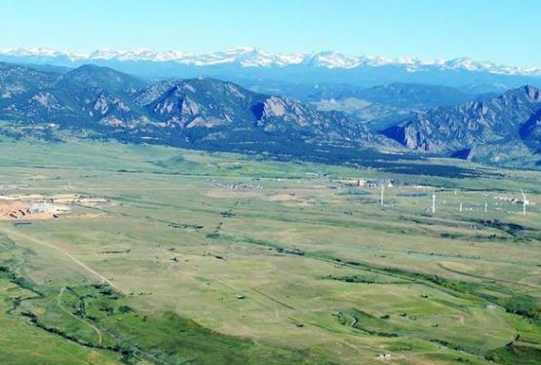
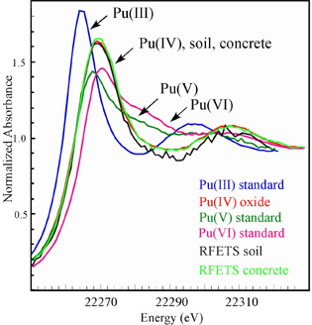
Case Study:
Rocky Flats Environmental Technology Site
Rocky Flats Plant: former nuclear weapons production facility near Denver, Colorado.
Considerable ground near surface contamination of Pu that had transported rapidly.
Transport mechanism was not known
Pre 90s
2006
XAS measurements at SSRL concluded Pu was in the insoluble chemical form PuO₂/PuO₂.nH₂O
Affirmed the erosion model used for site clean-up rather than the inappropriate soluble transport model
Stanford Synchrotron Radiation Light Source, United States.
Hardy, E. P.; Krey, P. W., "Plutonium in the Environs of the Former Rocky Flats Plant," Health Phys. 1996, 71, 796
Conradson, S. D.; Al-Mahamid, I.; Clark, D. L.; Hess, N. J.; Hudson, E. A.; Neu, M. P.; Palmer, P. D.; Runde, W. H.; Tait, C. D., "X-Ray Absorption Edges of Plutonium in Different Oxidation States," Polyhedron, 1998, 17, 599-602
Runde, W., "The Chemical Interactions of Actinides in the Environment," Los Alamos Science, 2000, 26, 338.
4
Notes:
I am sure the north american delegates are aware of this region. Former plutonium weapons facility that became heavily contaminated.
-use of XANES to analyse PuO2 through the stanford light source – found to be in the insoluble form.
-that a database was available
-use of a erosion model for the site cleanup rather than an inappropriate transport model.
-project finished well ahead of time and considerable sums of money were saved.

Slide 5
Unique capabilities and methods for analysing nuclear waste form materials using ANSTO’s landmark infrastructure
High temperature in situ redox chemistry of uranium using XAS
Neutron diffraction studies of actinides under high temperature and high pressure
High temperature Synchrotron X-ray diffraction studies of uranium under highly reducing conditions

Slide 6
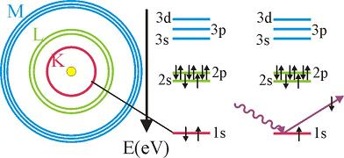
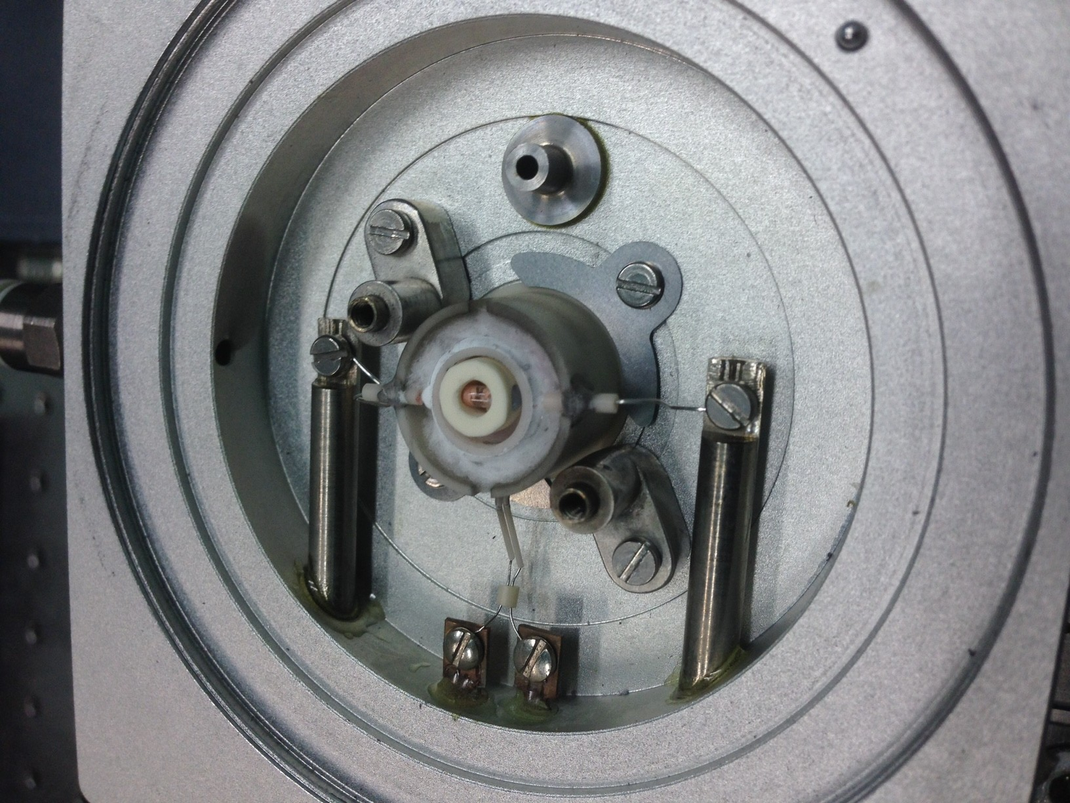
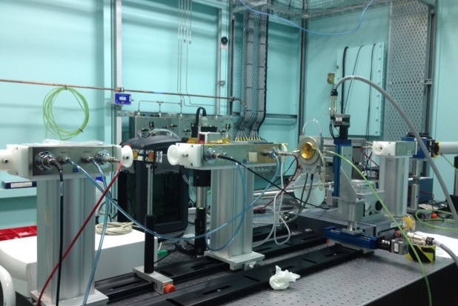
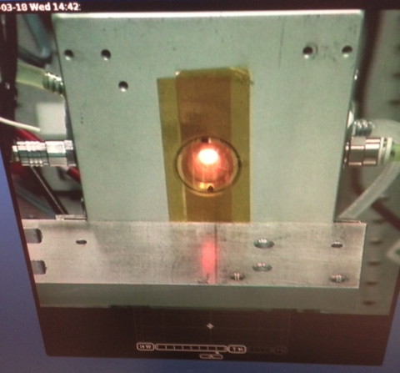
3rd Generation 4 GeV Synchrotron Light Source
In Situ X-ray Absorption
Spectroscopy
Active handling laboratories and facilities
Actinides can access a variety of valence states
U(IV) Insoluble in mildly acidic/basic environmental conditions
U(VI) Highly soluble in mildly acidic/basic environmental conditions and mobile
X-ray absorption spectroscopy allows the oxidation states of elements to be directly measured
X-ray Absorption Spectroscopy beamline, Australian Synchrotron, high temperature in situ set up
6

Slide 7
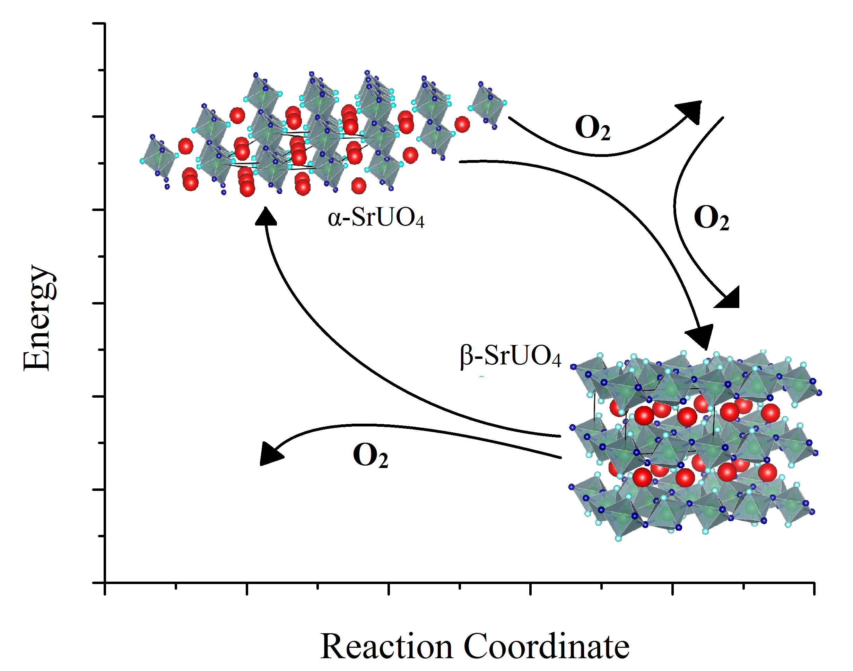
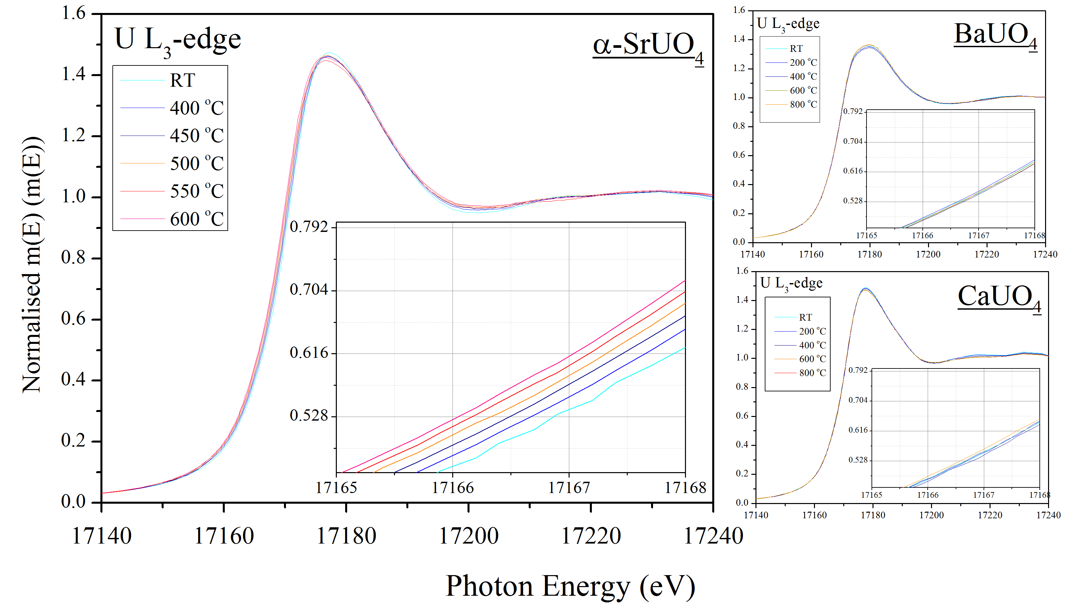
3rd Generation 4 GeV Synchrotron Light Source
In Situ X-ray Absorption
Spectroscopy
Active handling laboratories and facilities
Apparatus used to understand the apparent intermediate valence state changes in SrUO₄ phase transformations:
U⁶⁺
U^{5.2+}
U⁶⁺
U^{5.2+}
7
Murphy, G.; Kennedy, B. J.; Johannessen, B.; Kimpton, J. A.; Avdeev, M.; Griffith, C. S.; Thorogood, G. J.; Zhang, Z. M. J. Solid State Chem. 2016, 237, 86
Murphy, G. L.; Kennedy, B. J.; Kimpton, J. A.; Gu, Q. F.; Johannessen, B.; Beridze, G.; Kowalski, P. M.; Bosbach, D.; Avdeev, M.; Zhang, Z. M. Inorg. Chem. 2016, 55, 9329.
Notes:
Identifed SrUO4 as performing a strange oxygen breathing mode during its transformation.

Slide 8
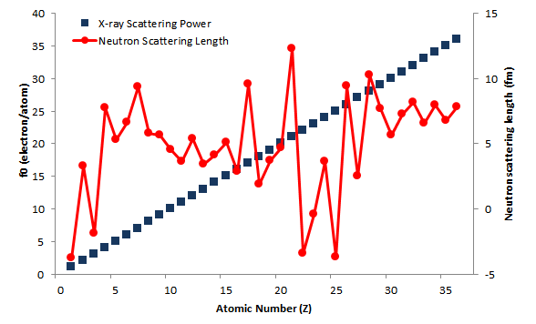
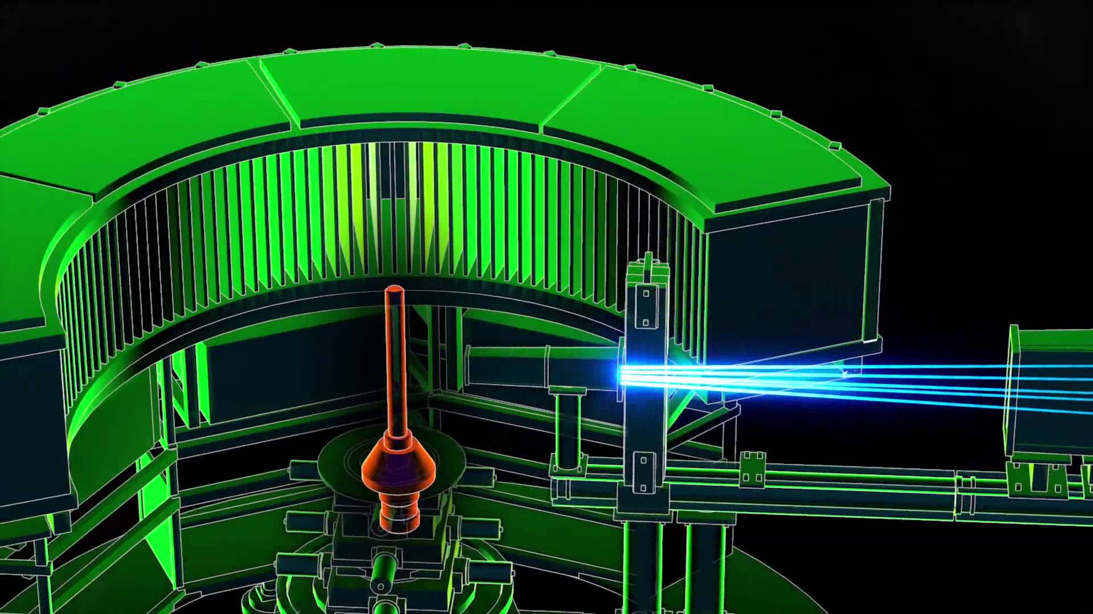
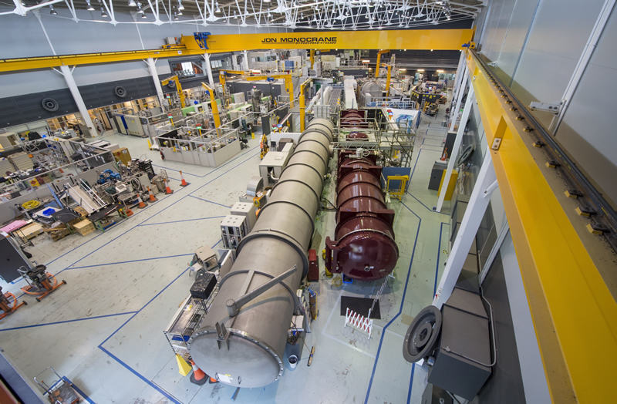
3rd Generation 4 GeV Synchrotron Light Source
In Situ High Temperature Neutron Powder Diffraction
Active handling laboratories and facilities
Understanding the behaviour of anions in the presents of actinides is pertinent as it has been related to key physical phenomena distinct to non actinides and also key moments in fuel operation e.g UO₂ melting.
Echidna High Resolution Diffractometer Equipped with High Temperature Vacuum Furnace.
Criticality needs to be considered in some instances particularly using fissile or fertile material e.g:
Th-232 + n → Th-233 → Pa-233 + ⁻β → U-233 + ⁻β
…With correct safety and protocols experiment should not be impeded
Skinner, L. B.; Benmore, C. J.; Weber, J. K. R.; Williamson, M. A.; Tamalonis, A.; Hebden, A.; Wiencek, T.; Alderman, O. L. G.; Guthrie, M.; Leibowitz, L.; Parise, J. B., Molten uranium dioxide structure and dynamics. Science 2014, 346 (6212), 984-987 Desgranges, L.; Ma, Y.; Garcia, P.; Baldinozzi, G.; Simeone, D.; Fischer, H. E., What Is the Actual Local Crystalline Structure of Uranium Dioxide, UO2? A New Perspective for the Most Used Nuclear Fuel. Inorg. Chem. 2017, 56 (1), 321-326.
8
Notes:
Heated alpha-SrUO4 up to 1000 C in air and using SXRD at the AS – 1st order transformation identified that is first order nature, as shown by the discontinuity of the alpha->beta peaks – cool, nothing exciting – looked at the rietveld refinement, peculiar observation of the increasing rate of change of volume, expansion, coincides with a strange oxygen loss phenomena of occuring on the O2 site.

Slide 9
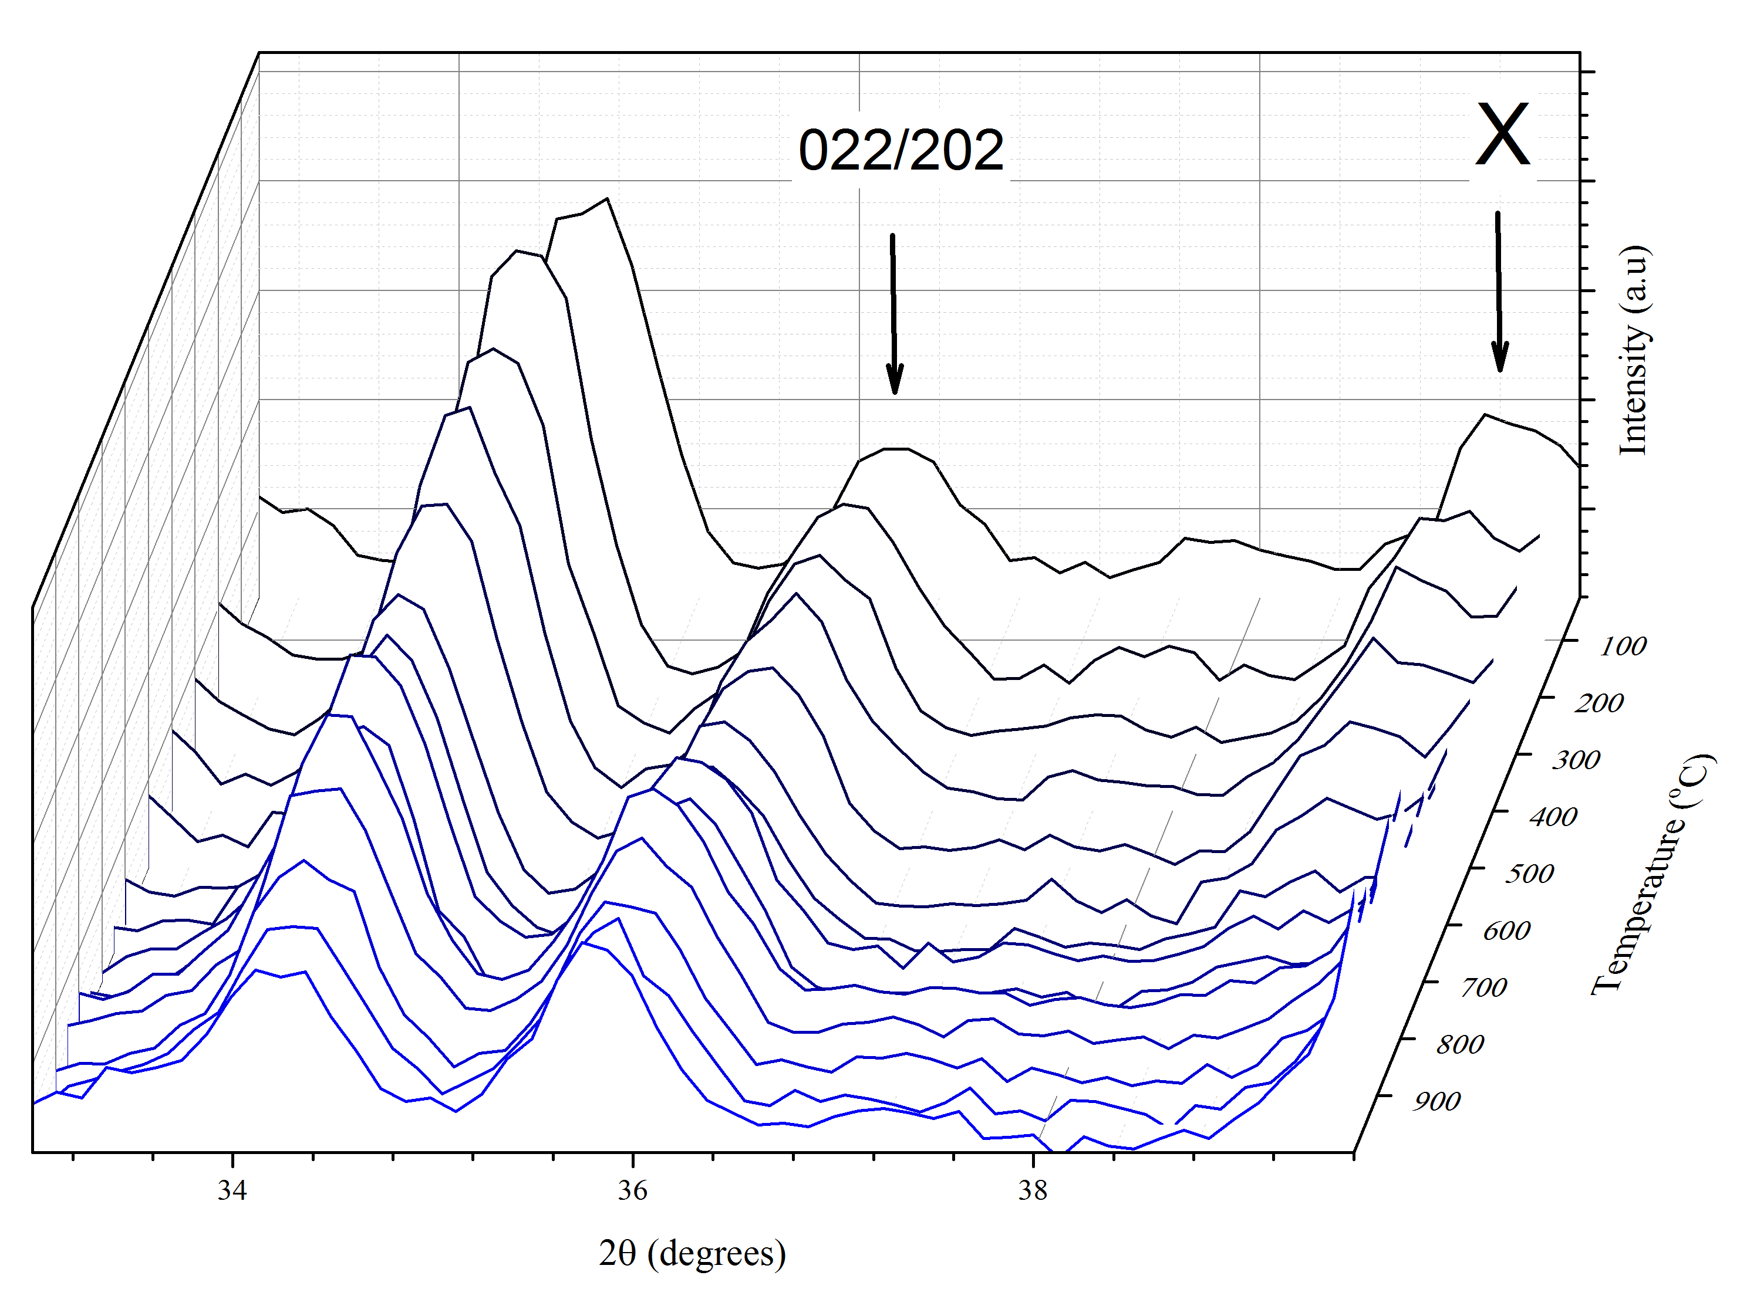
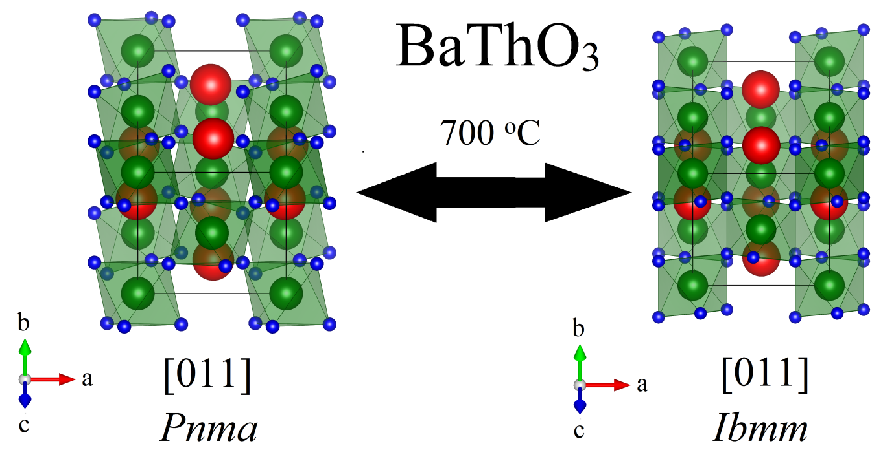
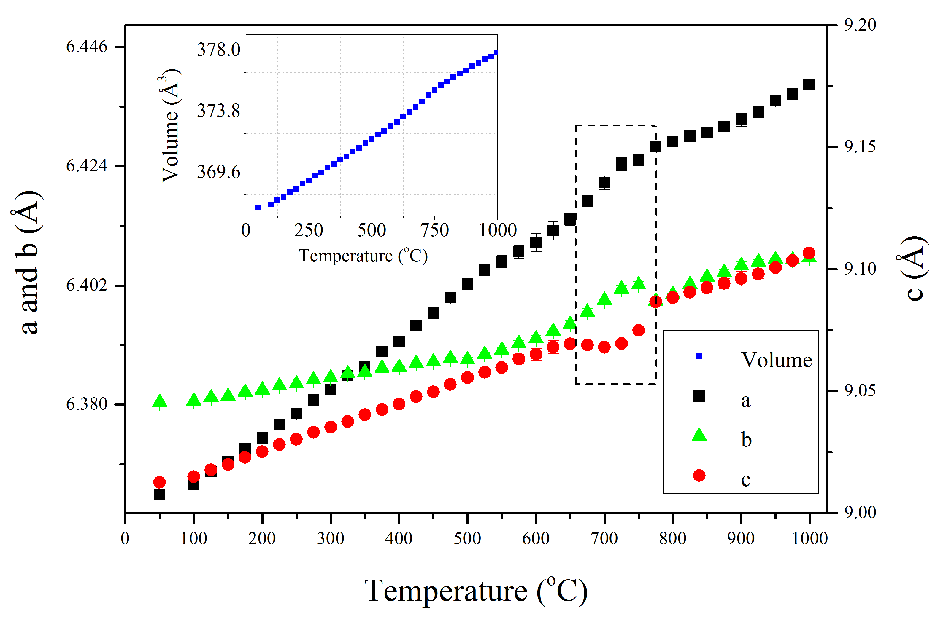
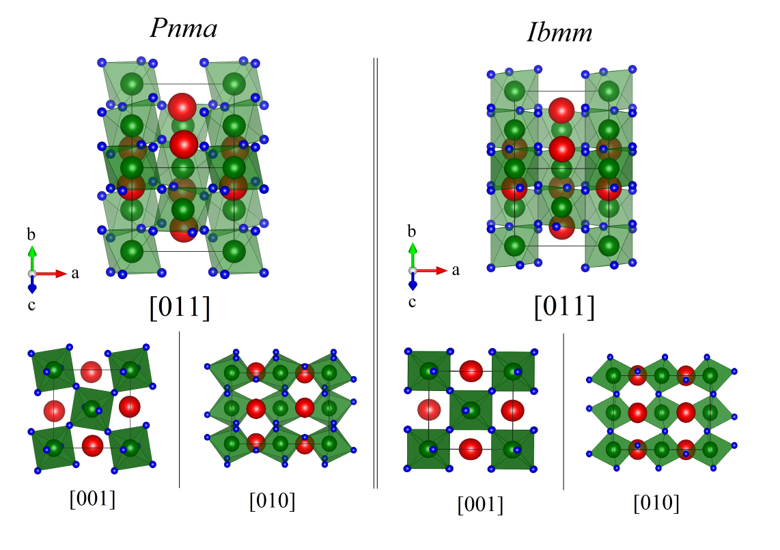
3rd Generation 4 GeV Synchrotron Light Source
In Situ High Temperature Neutron Powder Diffraction
Active handling laboratories and facilities
High temperature structural behaviour of BaThO₃ was examined using Echidna high resolution diffractometer equipped with vacuum furnace
Reversible phase transformation identified involving the cooperative tilting of ThO₆ polyhedra
Murphy, G. L.; Kennedy, B. J.; Zhang, Z.; Avdeev, M.; Brand, H. E. A.; Kegler, P.; Alekseev, E. V., Structure and phase transition in BaThO3: A combined neutron and synchrotron X-ray diffraction study. J. Alloy. Compd.
9
Notes:
Heated alpha-SrUO4 up to 1000 C in air and using SXRD at the AS – 1st order transformation identified that is first order nature, as shown by the discontinuity of the alpha->beta peaks – cool, nothing exciting – looked at the rietveld refinement, peculiar observation of the increasing rate of change of volume, expansion, coincides with a strange oxygen loss phenomena of occuring on the O2 site.

Slide 10
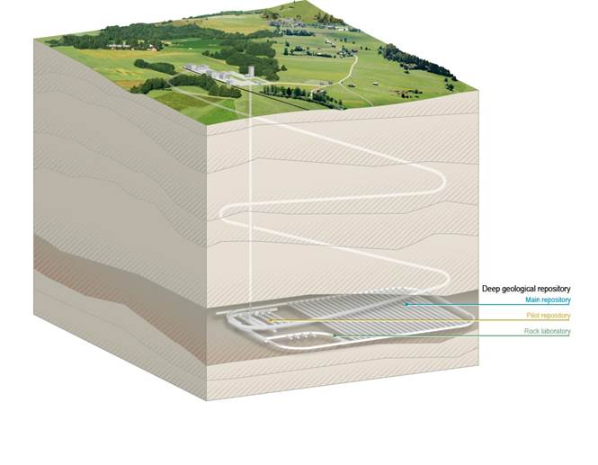
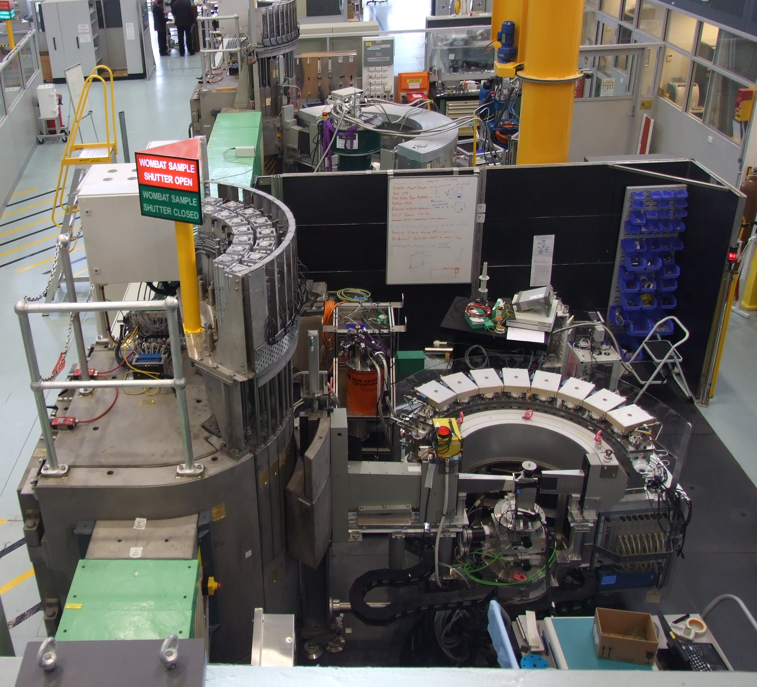
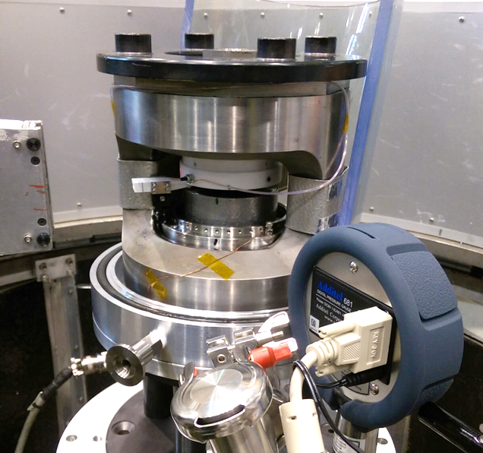
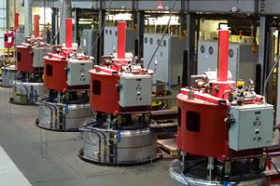
3rd Generation 4 GeV Synchrotron Light Source
In Situ High Pressure Measurements: Neutron powder diffraction
Active handling laboratories and facilities
Understanding the pressure dependence of nuclear materials is relevant both from a repository and waste form perspective
Wombat High Intensity Diffractometer Equipped with Paris-Edinburgh High Pressure Anvil Cell, OPAL Reactor
Deep Geological Nuclear Waste Repository Plan
Isostatic Presses for Glass/Ceramic Preparation
10
https://www.pressuretechnology.com/images/hip-capabilities-equipment-300.jpg
https://www.ensi.ch/en/wp-content/uploads/sites/5/2012/08/entsorgung-geologisches-tiefenlager-en.jpg
Notes:
Pressure – HIPING and respositories – looking towards the extreme condition of how actinides will respond to pressure.

Slide 11
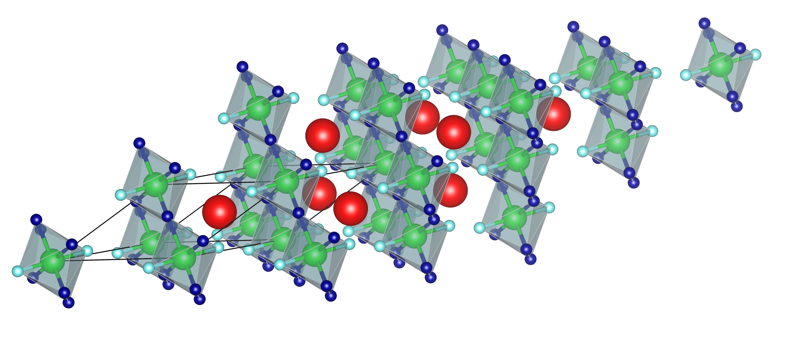

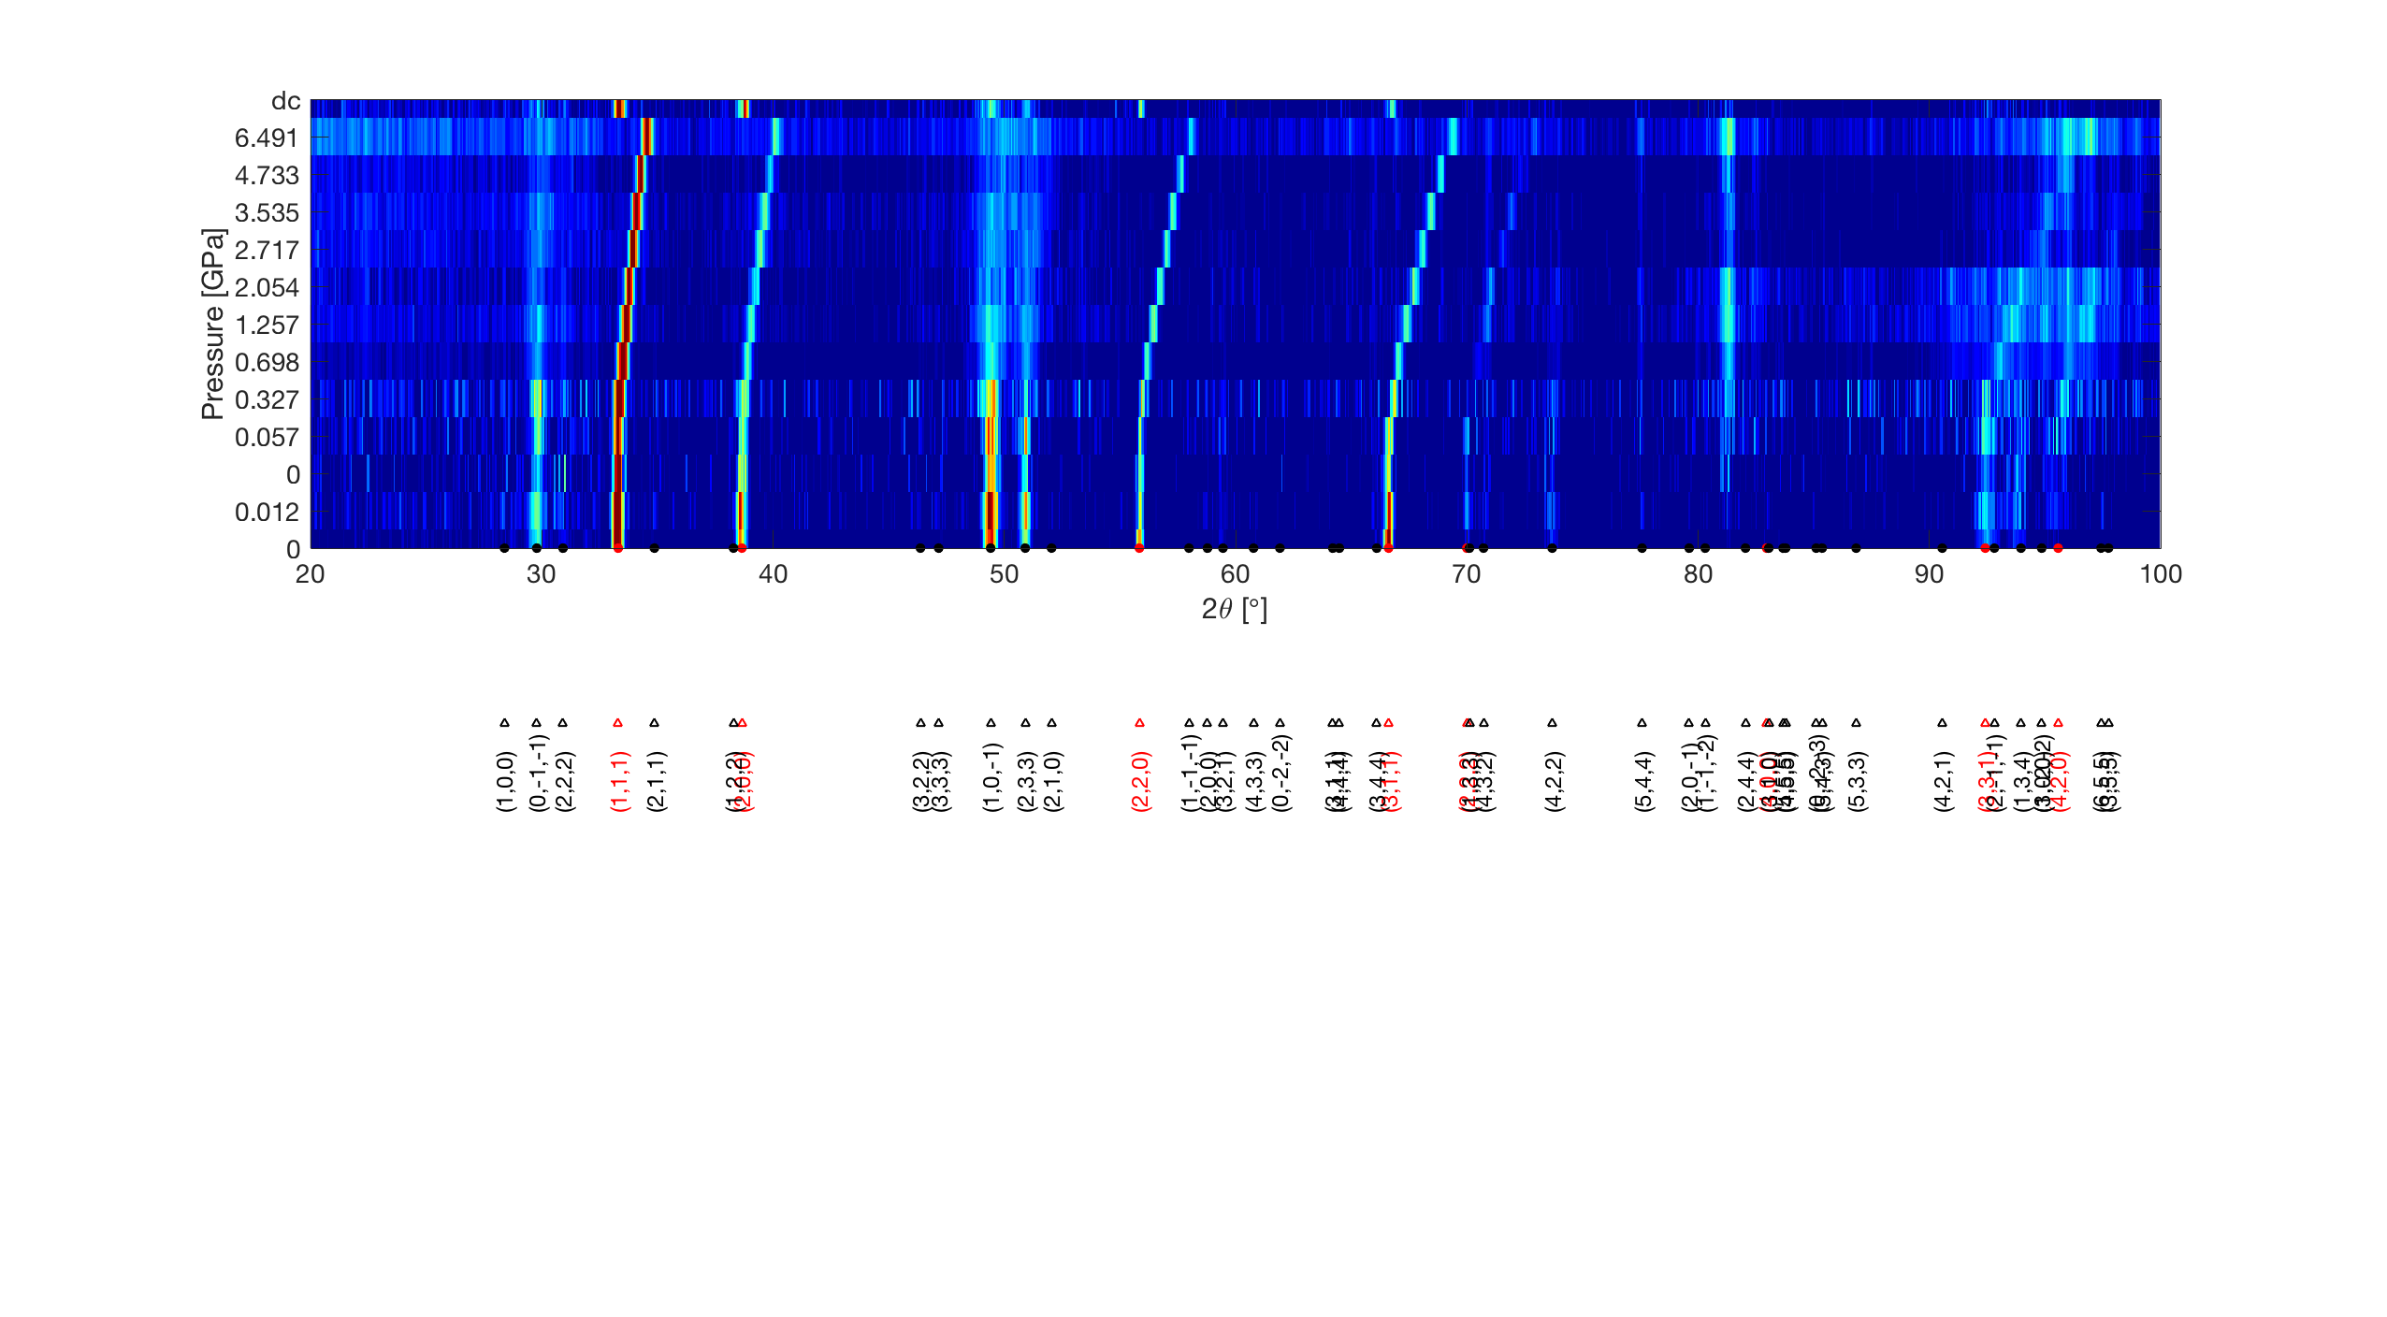
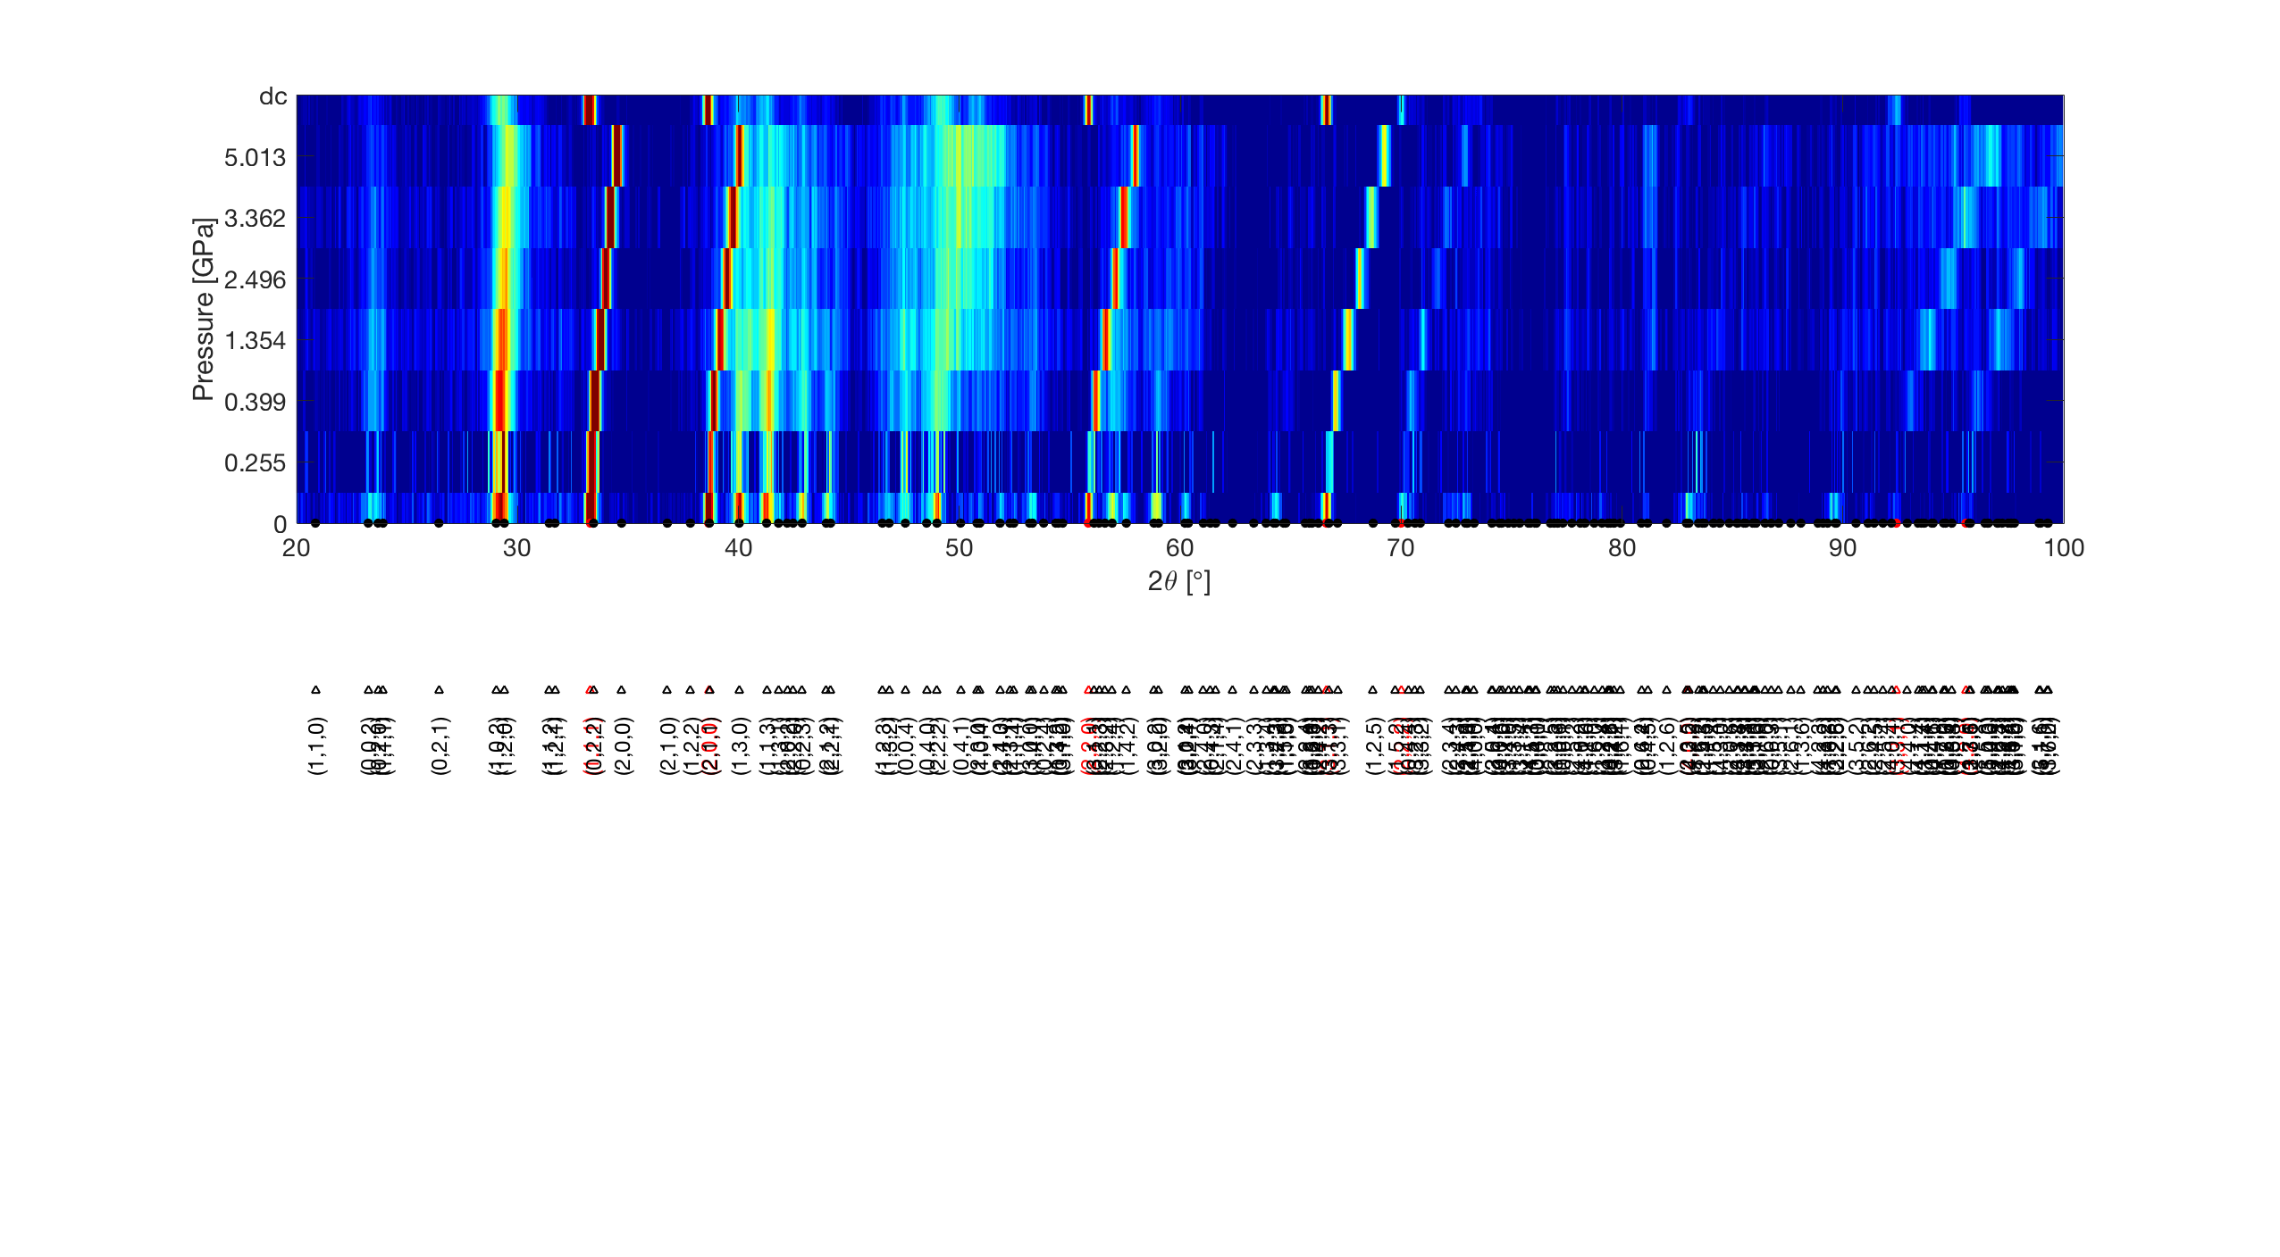
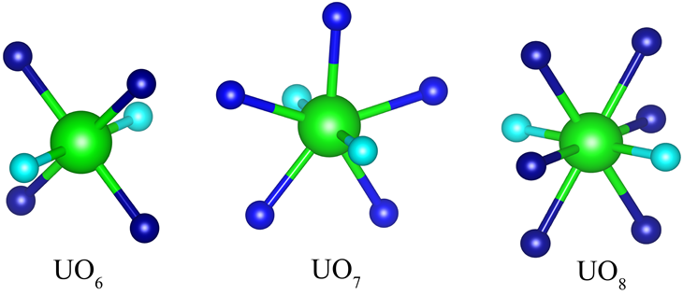
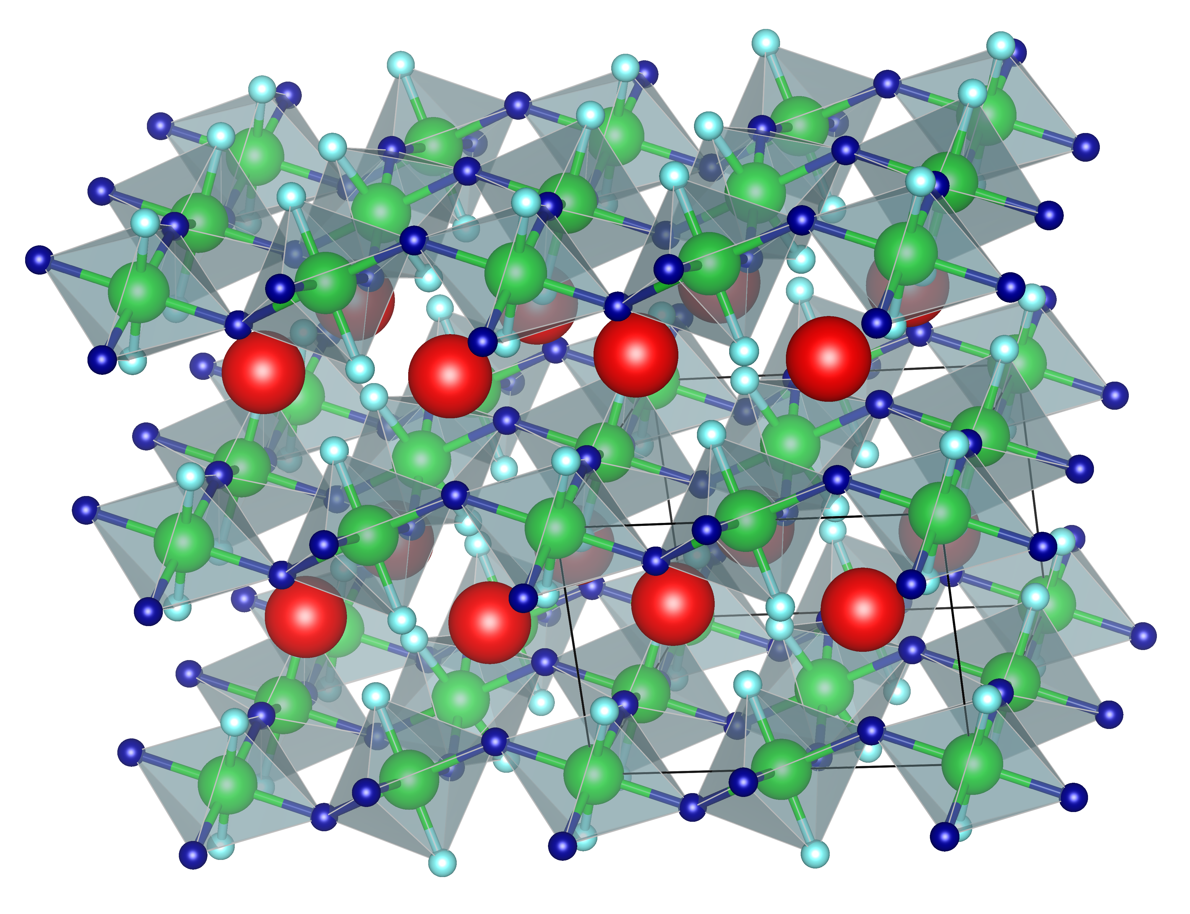
3rd Generation 4 GeV Synchrotron Light Source
In Situ High Pressure Measurements: Neutron powder diffraction
Active handling laboratories and facilities
The in situ pressure dependence of orthorhombic and rhombohedral forms of SrUO₄ was established with neutron diffraction:
Rhombohedral α-SrUO₄
Pressed to 6.5 GPa
Anisotropic compression of UO₆ and UO₈ polyhedra identified in both cases, violation of Badgers rule.
Orthorhombic β-SrUO₄
Pressed to 5 GPa
Isostatic Presses for Glass/Ceramic Preparation
α-UO₈
β-UO₆
11
Murphy and Muransky et al. in preparation
Notes:
Originally published by Richard Badger in 1934,^{[5]} this rule states that the strength of a bond correlates with the frequency of its vibrational mode. That is, increase in bond strength leads to corresponding frequency increase and vice versa. which implicitly contains a more general rule that a shorter bond has a larger stretching force constant.
Badgers door doesn’t work for uranyl group containing compounds. Effect predictability for instance in calculations.

Slide 12
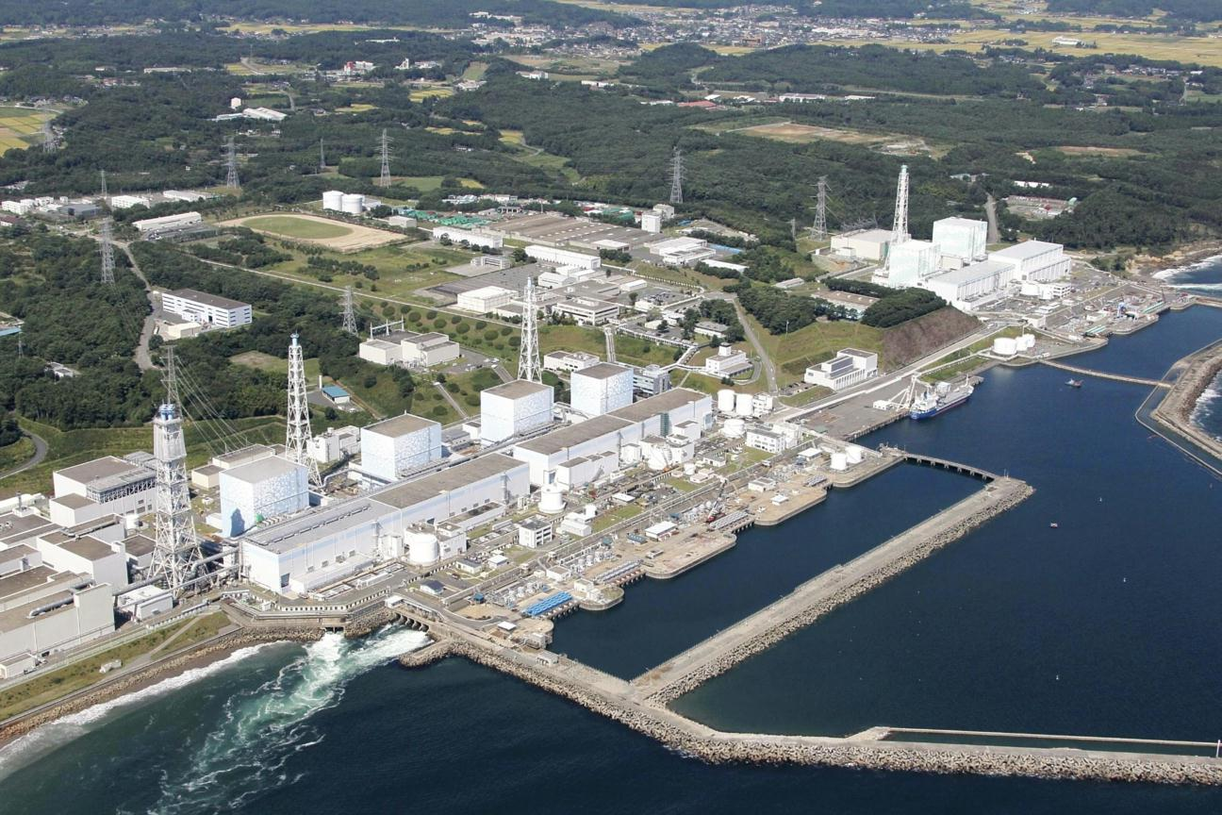
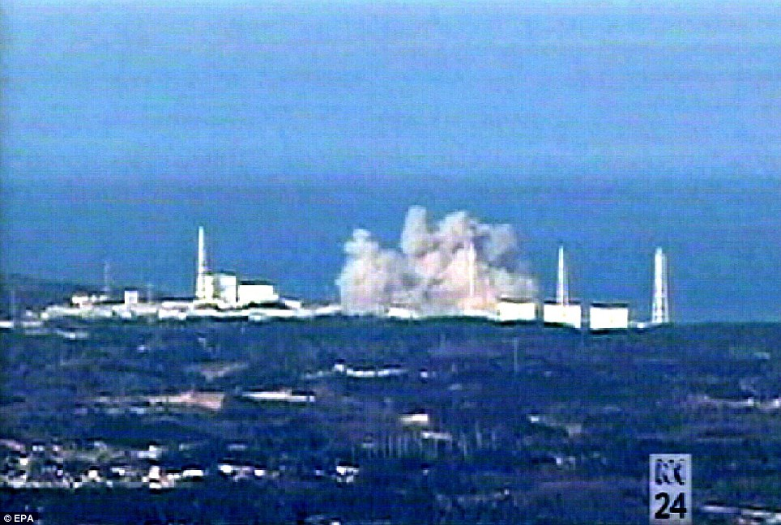
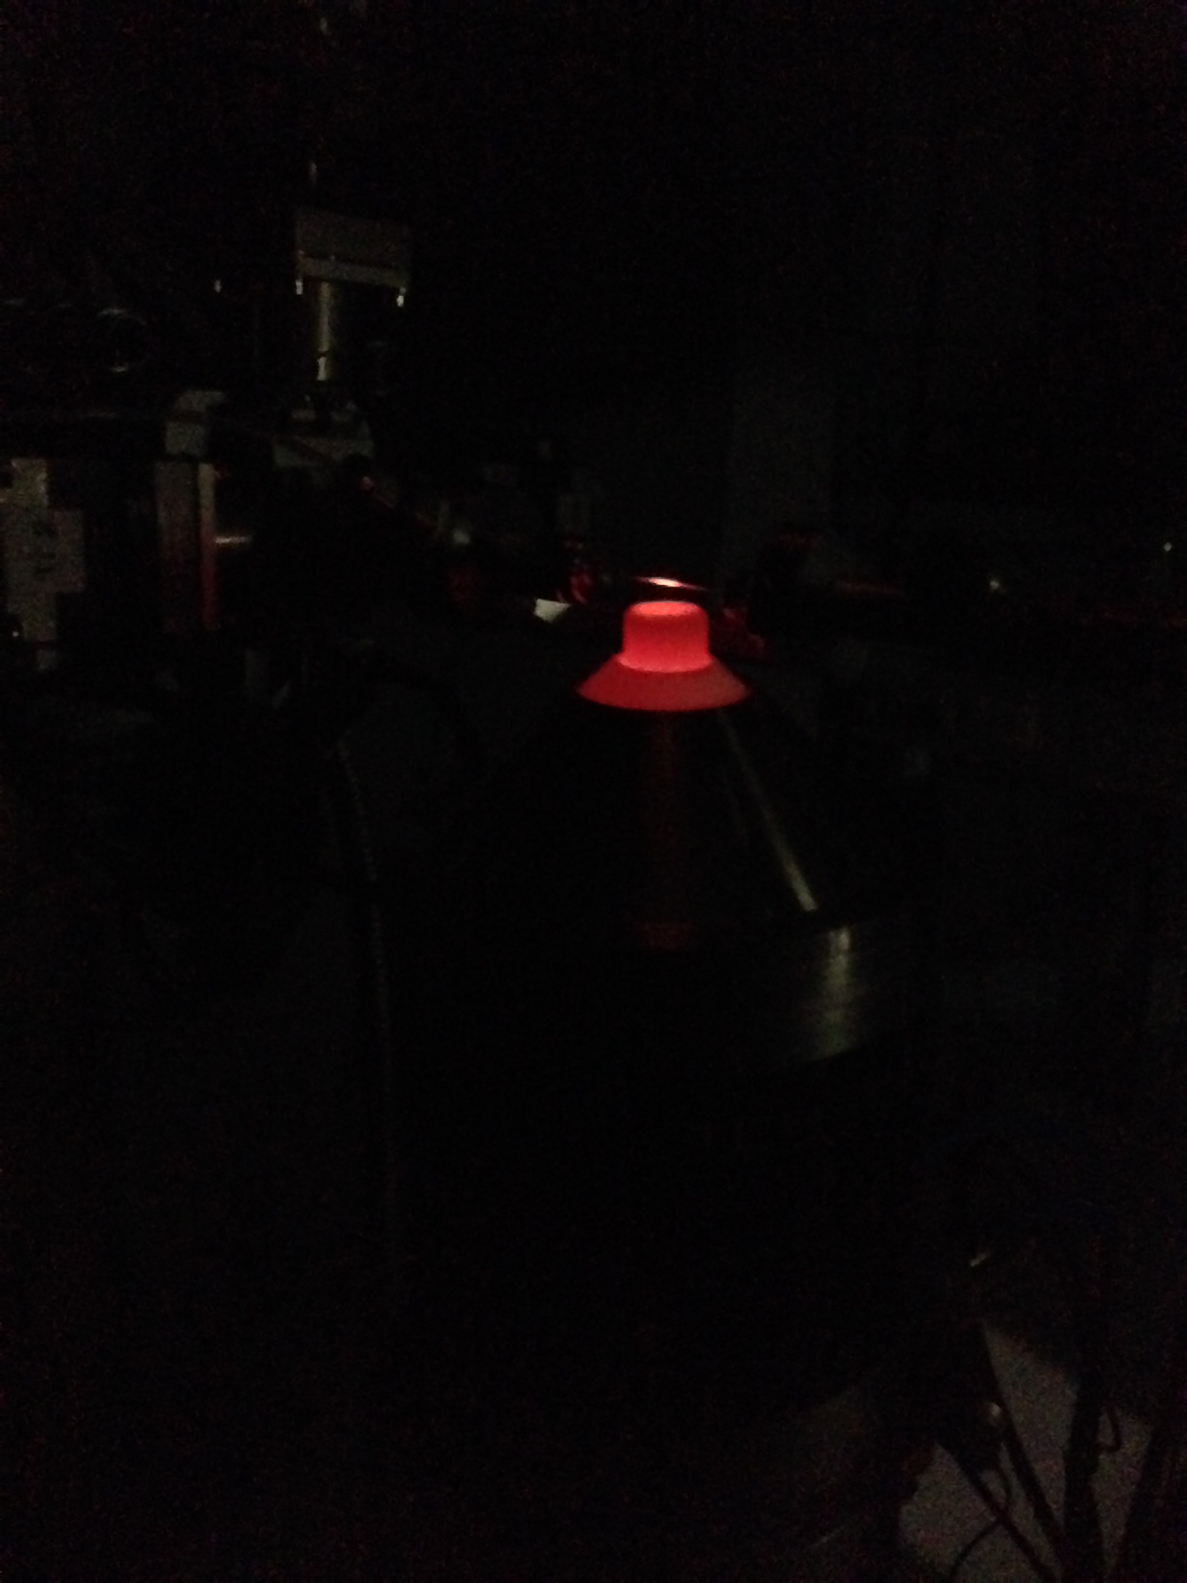
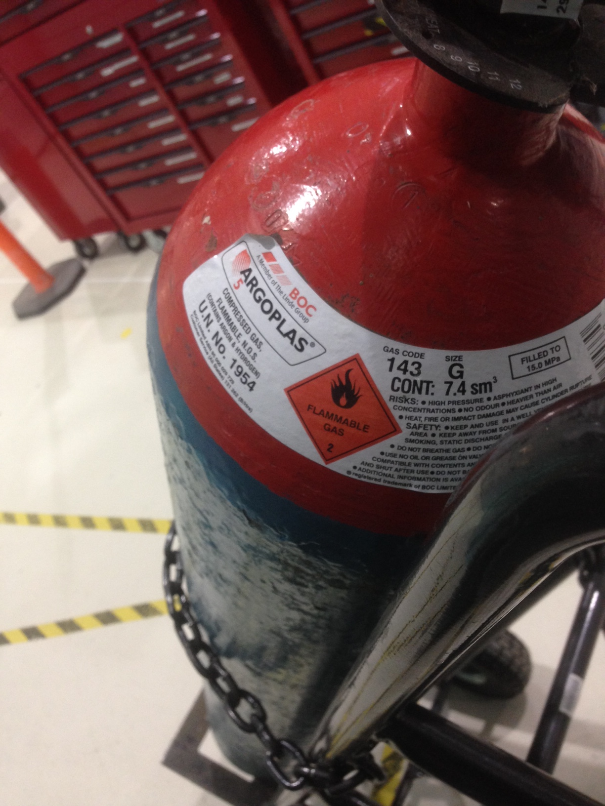
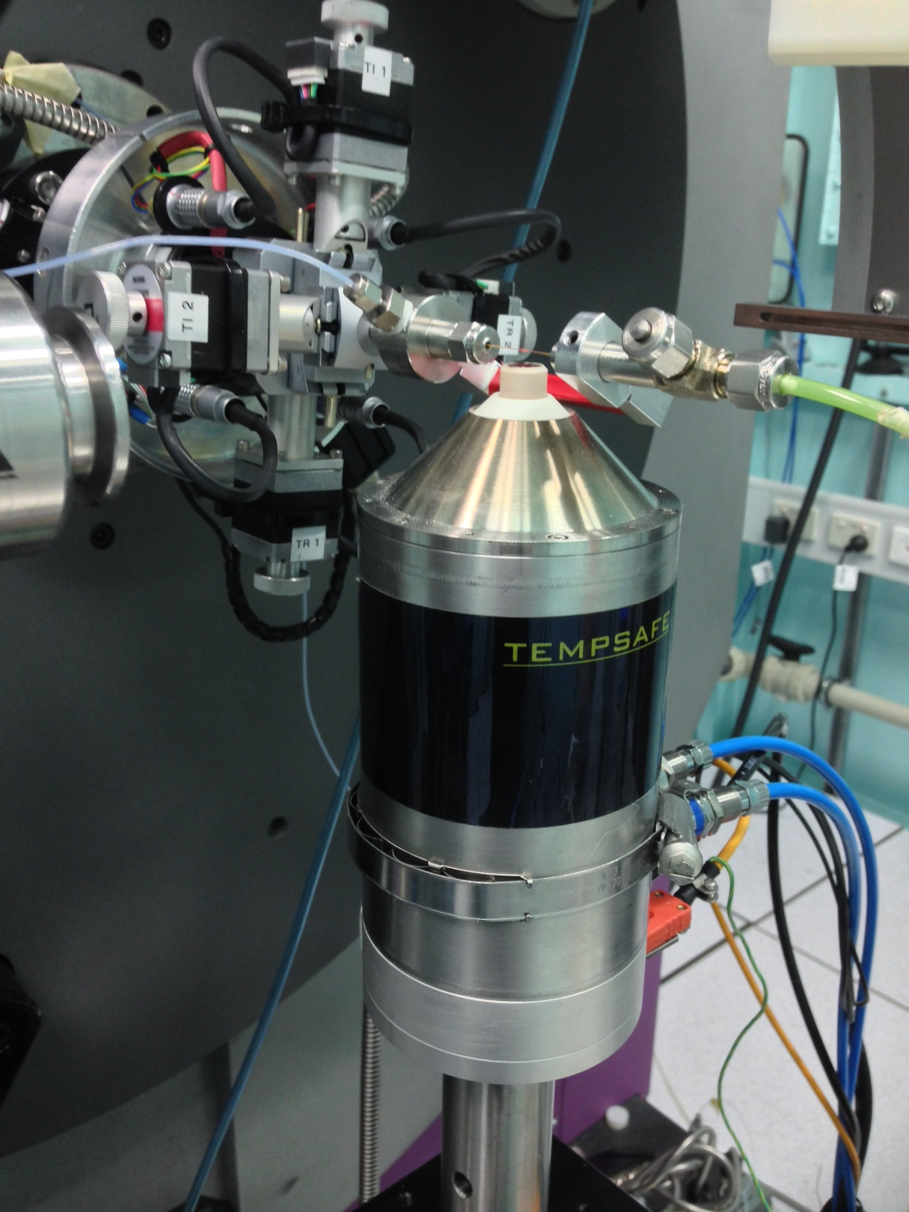
3rd Generation 4 GeV Synchrotron Light Source
In Situ X-ray High Temperature H₂ Gas Flow Synchrotron X-ray Diffraction
Studying the behaviour of actinides with H₂ at high temperature is highly challenging and notorious…
Powder Diffraction Beamline, Australian Synchrotron: Use of dynamic Norby-Flow Cell
Fukushima Daiichi Nuclear Reactor Facility Meltdown
https://cryptome.org/eyeball/daiichi-npp2/pict56.jpg
http://butane.chem.uiuc.edu/pshapley/GenChem1/L8/3rd.jpg
12
Notes:
Hydrogen exposure. Talks earlier in this week highlight what can

Slide 13
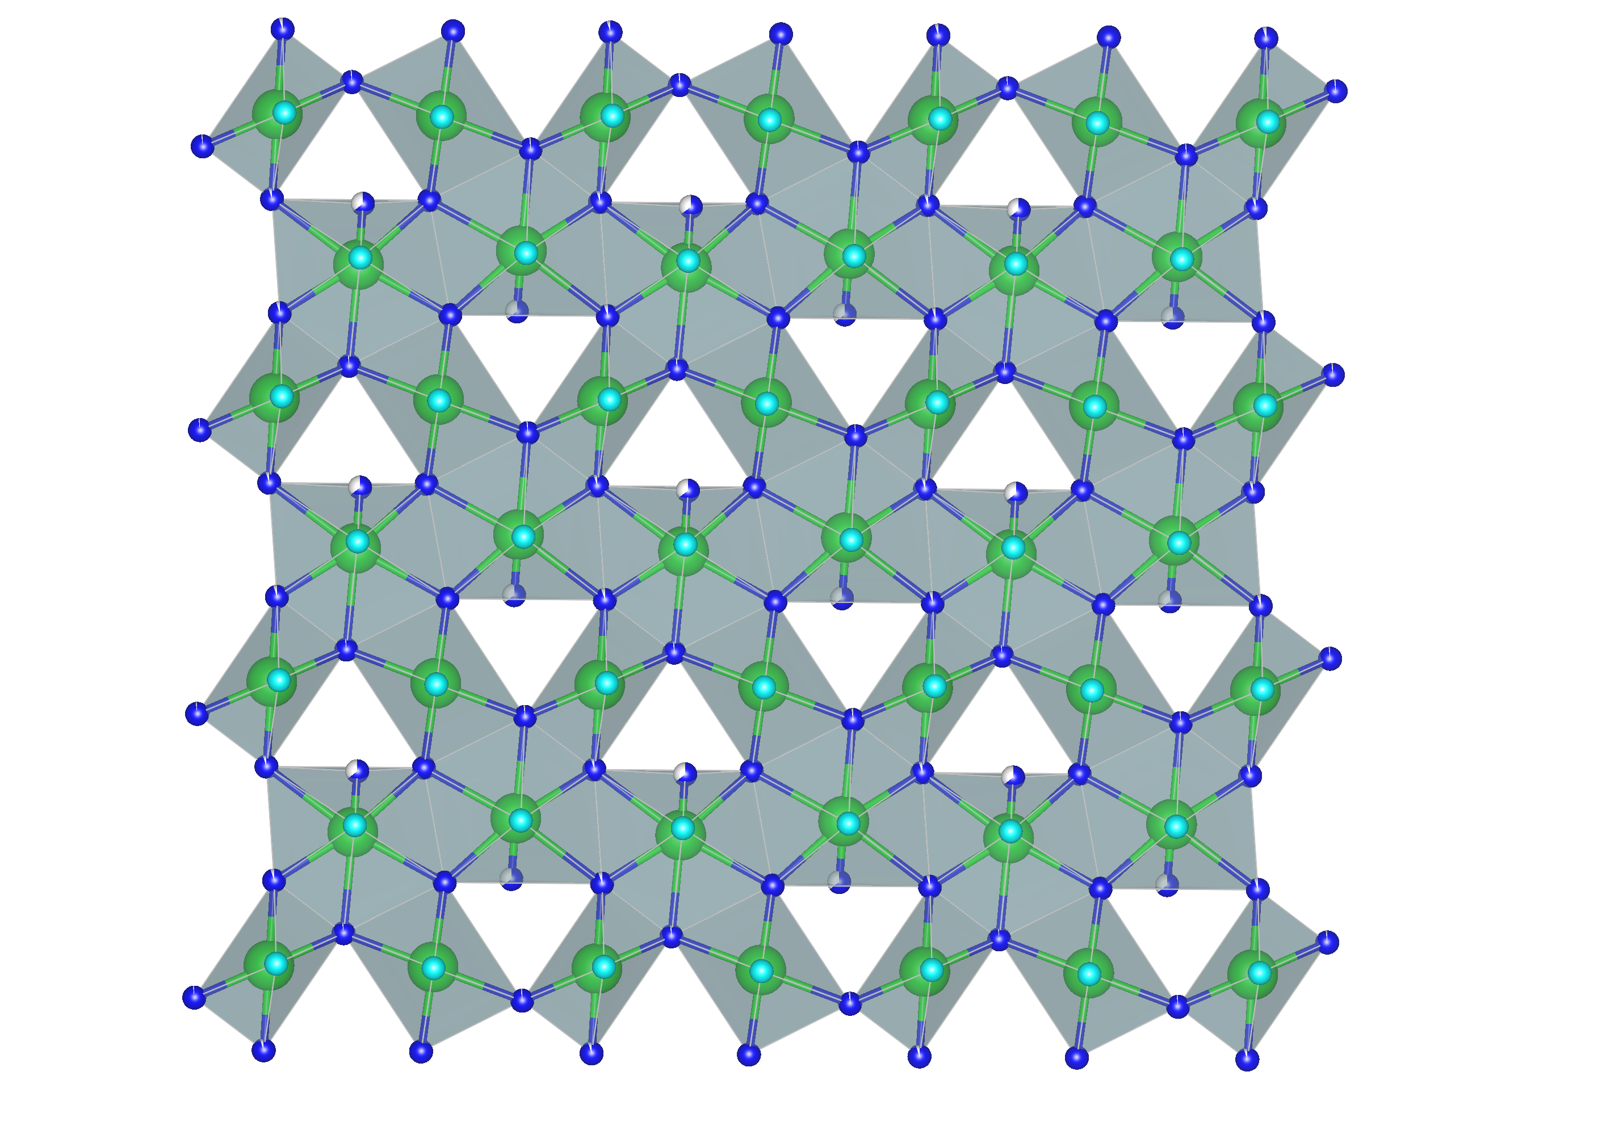
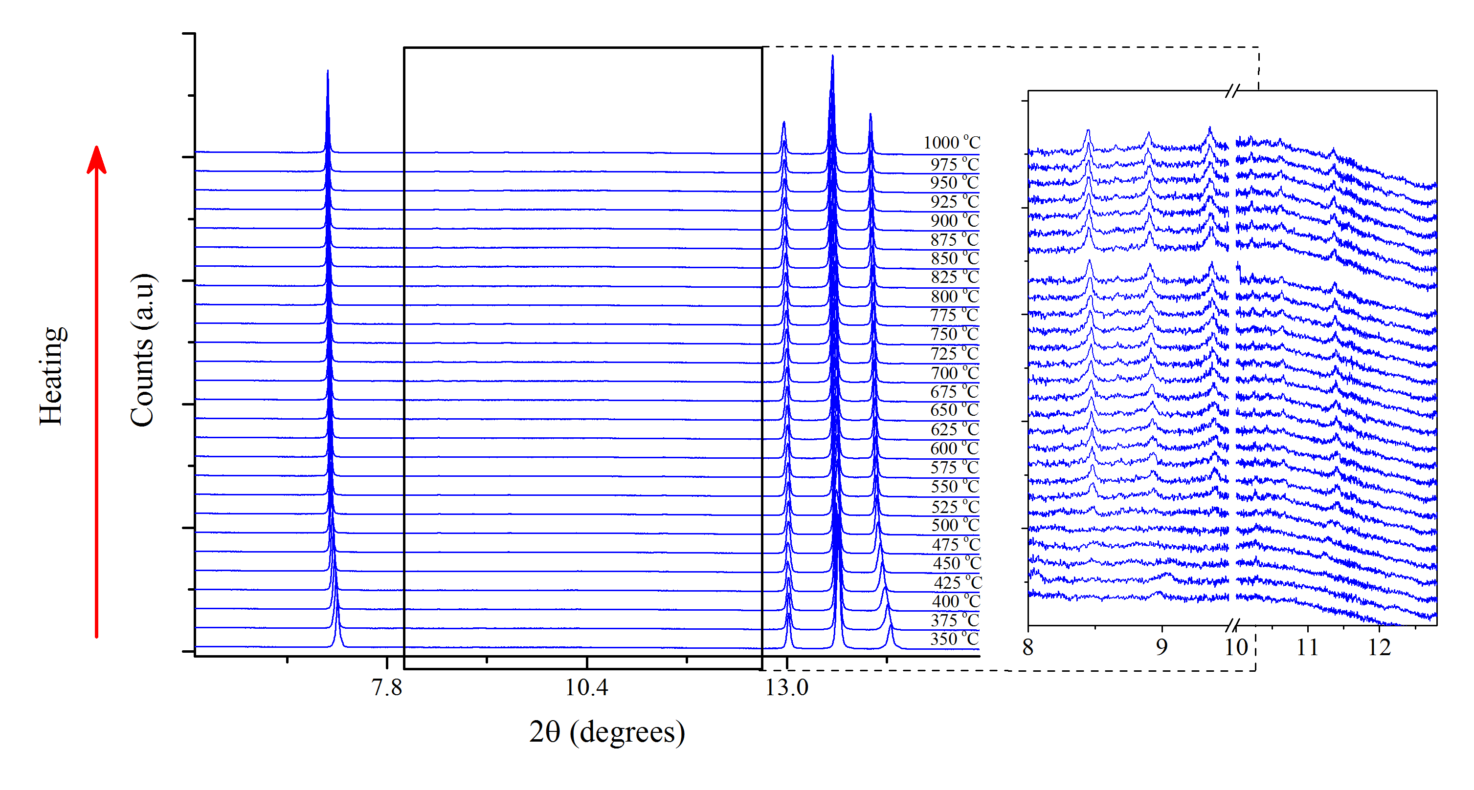
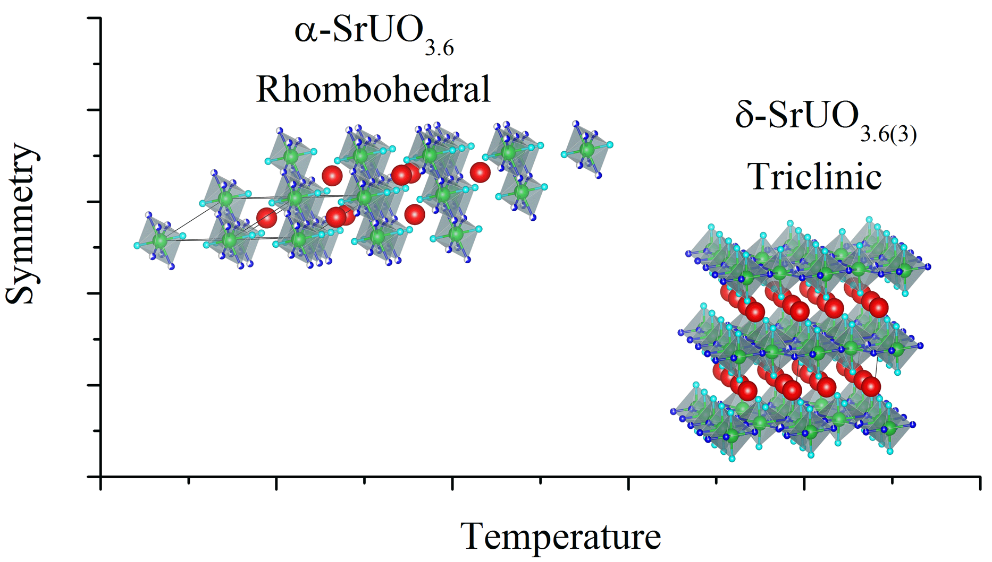
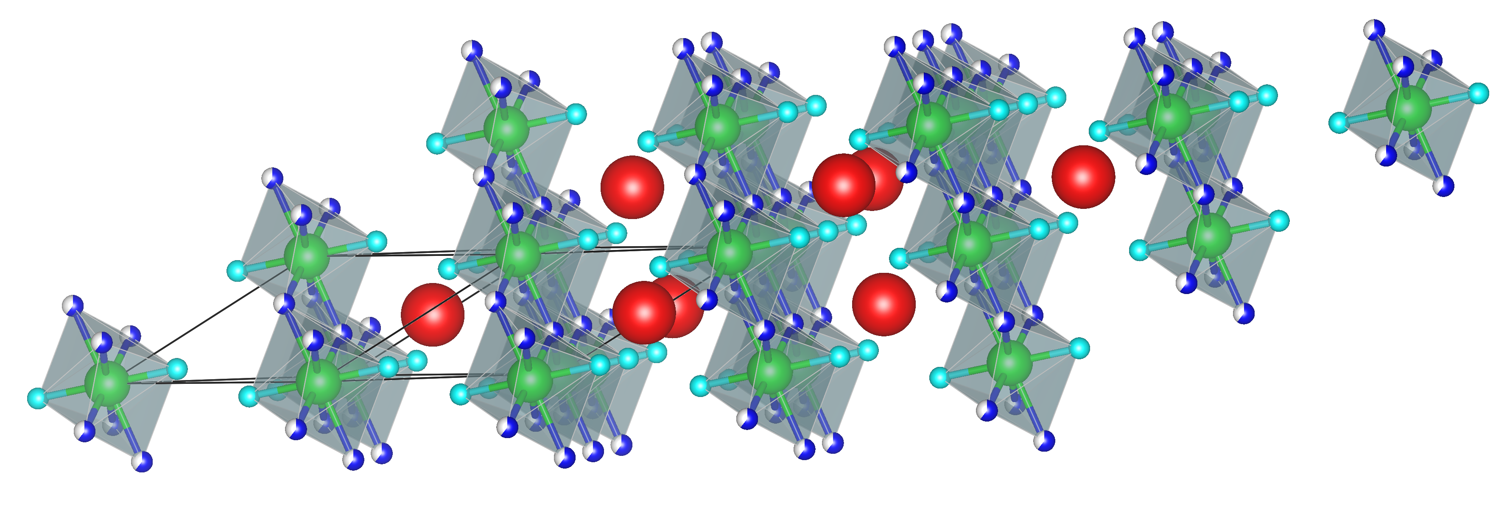
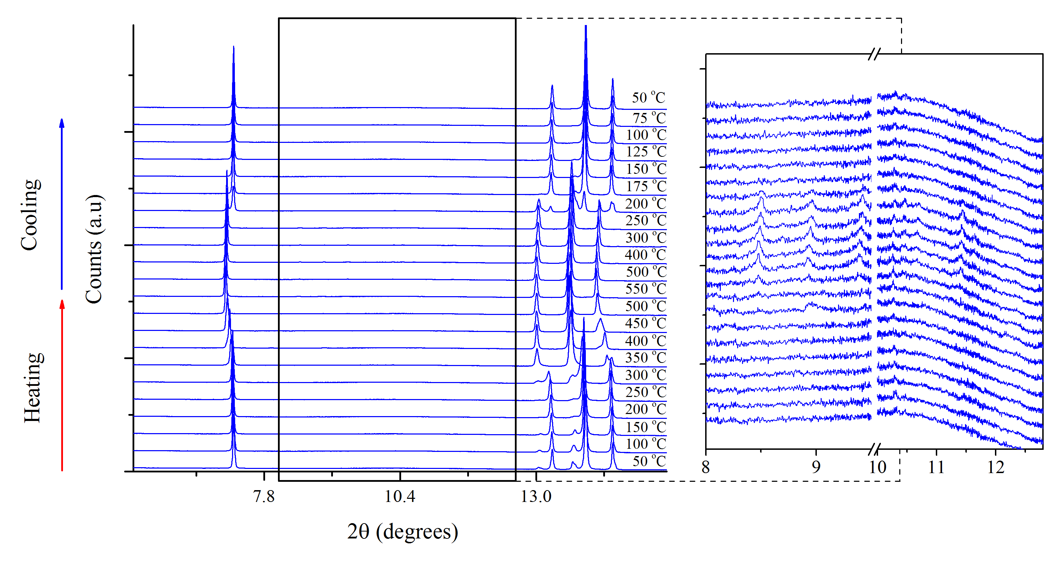
3rd Generation 4 GeV Synchrotron Light Source
In Situ X-ray High Temperature H₂ Gas Flow Synchrotron X-ray Diffraction
Rhombohedral α-SrUO_{3.6} was attempted to be reduced to α-SrUO_{3.5} using H₂ at 1000 ºC
U⁶⁺
U⁶⁺
U^{5+y}
U^{5+y}
High Temperature
U⁶⁺
U⁶⁺
U⁶⁺
U⁶⁺
U^{5+y}
U^{5+y}
U^{5+y}
U^{5+y}
U⁶⁺
U⁶⁺
U⁶⁺
U⁶⁺
U^{5+y}
U^{5+y}
U^{5+y}
U^{5+y}
U⁶⁺
U⁶⁺
U⁶⁺
U⁶⁺
U^{5+y}
U^{5+y}
U⁶⁺
U⁶⁺
Low Temperature
Mixed U^{6+/5+}
Mixed U^{6+/5+}
…Entropy seemingly decreases with increasing temperature
Murphy, G. L.; Wang, C. H.; Beridze, G.; Avdeev, M.; Zhang, Z. M.; Brand, H.; Kowalski, P. M..; Kennedy, B. J. An Unexpected Crystallographic Phase Transformation in Non-Stoichiometric SrUO4-x: Oxygen Defect Ordering and Symmetry Lowering with Increasing Temperature. 2017, In Preperation
13
Notes:
Heated alpha-SrUO4 up to 1000 C in air and using SXRD at the AS – 1st order transformation identified that is first order nature, as shown by the discontinuity of the alpha->beta peaks – cool, nothing exciting – looked at the rietveld refinement, peculiar observation of the increasing rate of change of volume, expansion, coincides with a strange oxygen loss phenomena of occuring on the O2 site.

Slide 14
3rd Generation 4 GeV Synchrotron Light Source
Conclusions and Outlooks
Experimentally
Completed several novel and exotic actinide experiments at the Australian Centre for Neutron Scattering and Australian Synchrotron.
Can replicate relevant and extreme scenario conditions relevant to the NFC and waste forms
Enabled other nuclear researchers to perform such research
Scientifically
Uncovered several unexpected and unique physiochemical properties seemingly unique to the actinides.
…Possibly broken the 2nd law of thermodynamics (maybe).
14
Notes:
Heated alpha-SrUO4 up to 1000 C in air and using SXRD at the AS – 1st order transformation identified that is first order nature, as shown by the discontinuity of the alpha->beta peaks – cool, nothing exciting – looked at the rietveld refinement, peculiar observation of the increasing rate of change of volume, expansion, coincides with a strange oxygen loss phenomena of occuring on the O2 site.

Slide 15


Acknowledgments
Professor Brendan J. Kennedy
Doctor Chun-Hai Wang
School of Chemistry, University of Sydney
Doctor Chris S. Griffith
Doctor Robert Gee
ANSTO Minerals
Doctor Zhaoming Zhang
Nuclear Fuel Cycle Research, ANSTO Mr Grant Griffiths
Nuclear Materials Development and Characterisation Platform ANSTO
Doctor Maxim Avdeev
Doctor Helen Maynard-Casely
Australian Centre for Neutron Scattering, ANSTO
Helen Maynard-Casely^{b} Helen Brand
Doctor Chris S. Griffith
-ANSTO Minerals, ANSTO
Doctor Justin A. Kimpton
Doctor Maxim Avdeev
-Australian Centre for Neutron Scattering, ANSTO
Doctor Justin A. Kimpton
Doctor Bernt Johannessen
Doctor Helen Brand
Australian Synchrotron, ANSTO.
Doctor Bernt Johannessen
-Australian Synchrotron, ANSTO
Grant Griffiths
NMDC, ANSTO
Doctor Qinfen Qu
15

