Slide 1


CAMS 2018
Advanced Materials and Manufacturing
November 27-29, University of Wollongong, NSW AUSTRALIA
School of Mechanical Engineering

Slide 2

Residual Stress Effects on Fatigue Crack Growth from a T-Butt Weld Toe
A.K. Hellier¹, H. Li¹, B.G. Prusty², G.M. Pearce²,
M. Reid³, A.M. Paradowska³
¹School of Mechanical, Materials, Mechatronic & Biomedical (MMMB) Engineering,
University of Wollongong, Northfields Avenue, Wollongong, NSW 2522, Australia;
²School of Mechanical & Manufacturing Engineering, UNSW Sydney
(The University of New South Wales), Sydney, NSW 2052, Australia;
³Australian Centre for Neutron Scattering,
Australian Nuclear Science & Technology Organisation (ANSTO),
Locked Bag 2001, Kirrawee DC, NSW 2232, Australia;
e: alanhellier@optusnet.com.au

Slide 3
Introduction
A350 grade black mild steel is one of the most widely used structural materials in the world, being commonly found in buildings, bridges and offshore structures.
Welding is commonly used to join two plates of structural steel and this often takes the form of a T-butt.
In addition, other more complex geometrical joints are often simplified for stress analysis purposes by approximating them as 2-D T-butt plate models (e.g. skewed T-joints, cruciform welded joints, tubular welded joints, pipe–plate joints, etc.).
However, all such welds are potentially susceptible to fatigue crack initiation and slow but accelerating growth arising as a result of fluctuating service loads, often eventually resulting in fast fracture.

Slide 4
Ultrasonic Peening
Ultrasonic peening, more properly known as ultrasonic impact treatment (UIT), is a relatively recent development of the well-established shot peening process.
It was originally invented in 1972 in the former USSR to improve the fatigue and corrosion performance of ship and submarine hulls.
UIT is similar to conventional needle or hammer peening in many respects.
An important difference is that rather than using a pneumatic tool, which causes the needles or a single hammer-like rod to impact the weld surface at a frequency of 25-100 Hz, with UIT, the weld is impacted by a smaller number of rods vibrating at a much higher frequency on the order of 18,000-27,000 Hz.

Slide 5
Ultrasonic Peening (continued)
This makes it a much quieter device, which vibrates at a lower intensity, so that the operator can use it for longer periods of time before tiring.
Ultrasonic peening is relatively cheap, can be applied in-situ and offers significant improvements in the lifespan of welded components when applied correctly.
This occurs for three different reasons:-
removal of weld defects;
reduction of stress concentration;
redistribution of tensile stresses and/or introduction of compressive stresses.

Slide 6
Experimental Welding
Dimensions were 800×160×10mm for the base plate and 100×160×10mm for the attachment plate of each T-butt.
During fabrication two base plates were tack welded back-to-back prior to welding of the double-beveled attachment plate to each, in order to minimize distortion.
Balanced full-penetration GMAW fillet welding was employed, with six passes on each side.
All welds passed ultrasonic testing (UT) for internal flaws and magnetic particle inspection (MPI) for surface flaws.

Slide 7
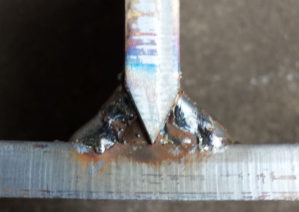
Weld detail of typical T-butt joint before buffing.
Note six weld passes on each side.

Slide 8
Neutron Diffraction
Through-thickness residual stresses were measured from the weld toe into the base plate for as-welded, post weld heat treated (PWHT) and ultrasonically peened specimens using the KOWARI instrument at ANSTO.
The (non-destructive) neutron diffraction technique was chosen for this study because of its ability to measure thee-dimensional residual stress deep within the component at high resolutions.
For the neutron measurements a 0.5×0.5×1mm³ gauge volume was used for the longitudinal, transverse and normal components.
The raw residual stress results measured during the as-welded and PWHT scans require considerable post-processing and were unavailable at the time of writing.

Slide 9
Experimental Residual Stresses
Although the nominal yield stress of the A350 grade plate is 350 MPa the actual yield stress is generally higher, in this case averaging out to about 400 MPa.
Ultrasonic peening was highly effective, leading to a residual stress redistribution with a maximum compressive stress of about 250 MPa at the weld toe surface and a maximum tensile stress of 220 MPa, at a depth of almost 3mm into the base plate.

Slide 10
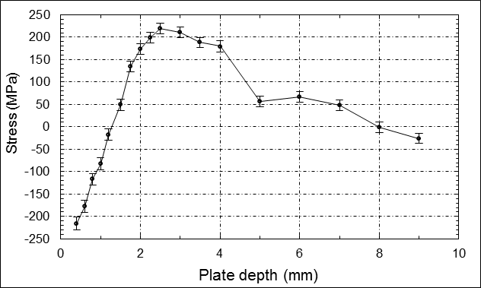
T-butt weld toe through-thickness residual stresses after ultrasonic peening.
Error bars are shown for each measurement.

Slide 11
As-Welded Residual Stresses from Literature
A typical as-welded residual stress distribution from the literature was used in this preliminary study.
The sample investigated using neutron diffraction with a 2×2×2mm³ gauge volume was a T-plate fillet weld, joining two 25mm thick plates.
The plate material was BS 7191 grade 355 EMZ structural steel, which is very similar to A350 grade steel, and represents a large group of steels commonly used in the nuclear and offshore industries.
SMAW welding with standard filler metal was used.
Both welds consisted of four weld passes in an alternating sequence between the two sides.
Centre line results were scaled horizontally to fit a 10mm thick plate.

Slide 12
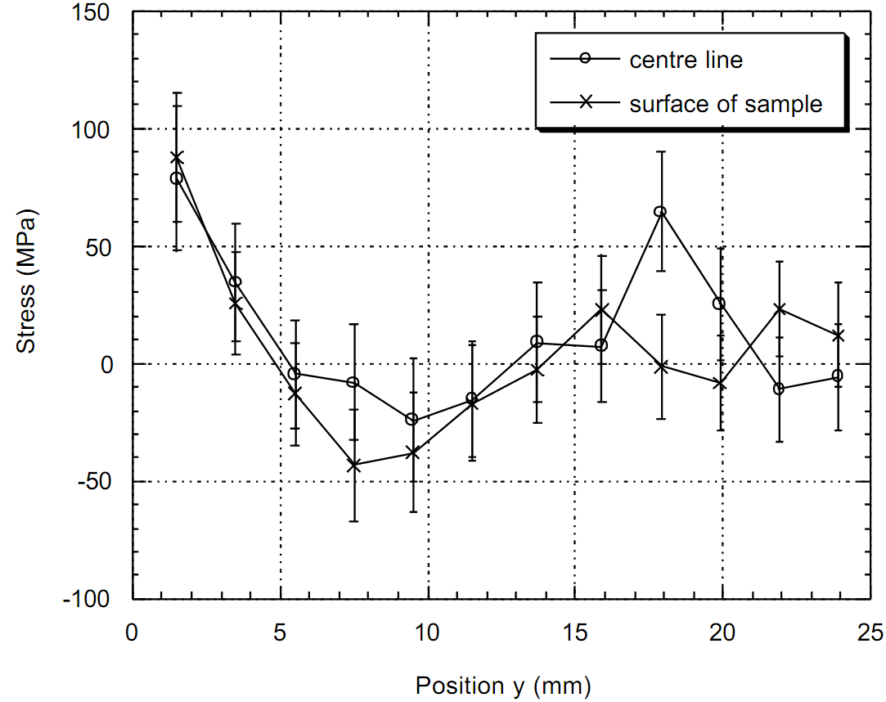
Residual Stress Distribution from Literature

Slide 13
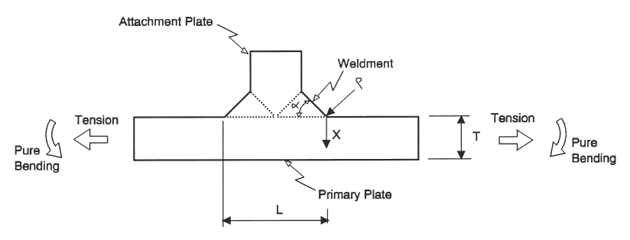
Geometry of T-Butt Weldments Studied

Slide 14
2-D Finite Element Analyses
80 2-D plane stress FE analyses of T-butt welds were conducted.
Plane stress was used to ensure the resulting applied stresses are the highest possible (to be conservative).
By contrast, when measuring the resistance to crack growth, plane strain gives the lowest possible stress (again to be conservative).
Weldment angle (α), weld toe radius (ρ), weld attachment width (L), and plate thickness (T) were varied for tension (membrane) loading.
The geometry validity limits for all the equations developed are:-
Weld angle: 30°<α<60°
Weld toe radius: 0.01<ρ /T<0.066
Attachment width: 0.3<L/T<4.0
The weld attachment width is twice the attachment plate thickness.

Slide 15
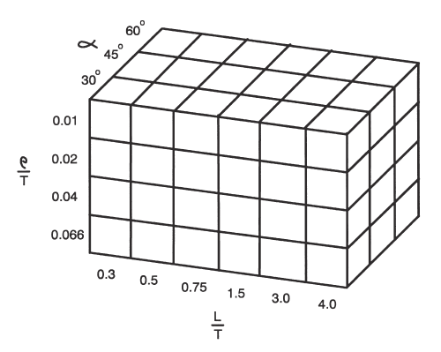
Matrix of Geometrical Parameters Analyzed

Slide 16
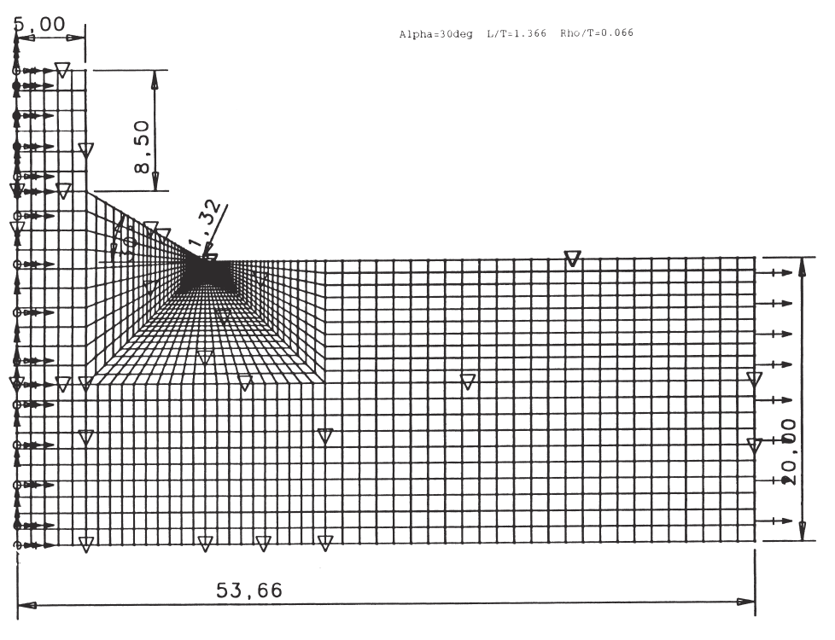
Finite Element Mesh (dimensions in mm)

Slide 17
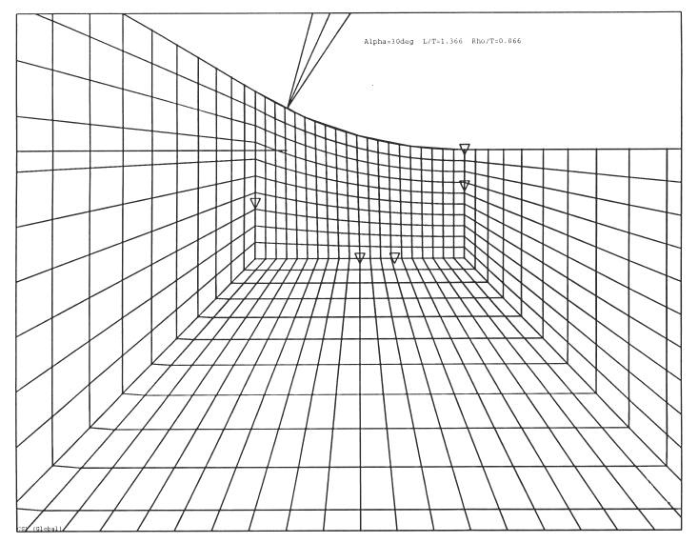
Finite Element Fillet Radius Detail

Slide 18
HBC Full SCF Parametric Equation
SCF^{m}_{w0} = 0.889 – 0.302α + 3.44(ρ /T) + 0.529(L/T)
+ 0.012α² + 104(ρ /T)² – 0.633(L/T)²
– 0.614α³ + 0.18(L/T)³
– 0.018(L/T)⁴ – 35.5α(ρ /T)
– 0.153α(L/T) + 4.38(ρ /T)(L/T)
+ 30.6α²(ρ /T) – 0.219α²(L/T)
– 64.3α(ρ /T)² + 0.041α(L/T)²
– 54.5(ρ /T)²(L/T) + 0.595(ρ /T)(L/T)²
+ α^{0.68}(ρ /T)^{–0.299}(L/T)^{0.263} (1)
The histogram of percentage errors is narrow and sharply peaked, with the values all lying between –3.8% and +3.1%.
The equations were published in 2014 in Adv. Mater. Research.

Slide 19
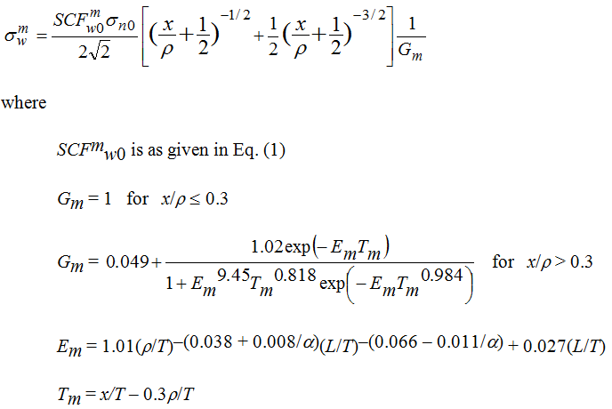
HBC Stress Distribution Parametric Equation
(2)

Slide 20
BDKH SIF Y-Factor Parametric Equations
Existing BDKH parametric equations are available for T-butt weld toe stress intensity factor (SIF) geometric Y-factor at the deepest point of a semi-elliptical surface crack, subject to tension (membrane) and pure bending loadings.
These are based on the same 80 2-D FE analyses as the HBC equation, where a is the crack depth and c is the semi-crack width.
The following additional crack geometry validity limits apply:-
Range of crack aspect ratios: 0<a/c<1.0
Range of crack depths: 0.01<a/T<1.0
These equations were commissioned by the Marine Technology Support Unit of the UK Health and Safety Executive back in 1995.
A comprehensive verification study was subsequently conducted on both equations involving the generation of 160 tables and 81 plots.
The equations were published in 1999 in the Int. J. Fatigue.

Slide 21
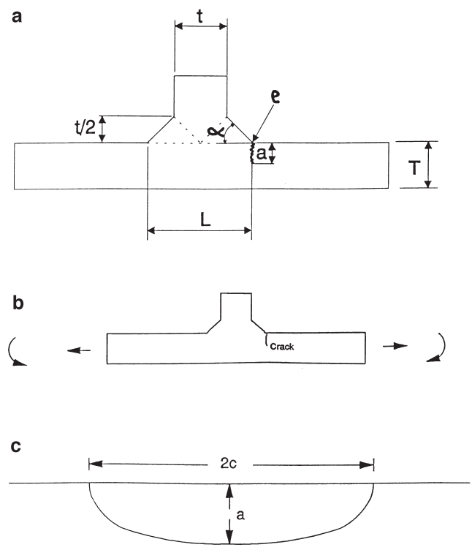
Weld Showing Semi-Elliptical Crack Geometry

Slide 22
Assumed T-Butt and Crack Geometry for Runs
Weld angle, α = 45°
Weld toe radius, ρ = 0.1mm
Main plate thickness, T = 10mm
ρ /T = 0.01
Welded attachment width, L = 30mm
L/T = 3 (chosen to be close to 2.8 as for Monahan’s SCF and stress distribution equations)
Initial semi-elliptical crack depth, a_{i} = 0.1mm or 1mm
Initial semi-elliptical crack width, c_{i} = 1mm or 10mm
Initial full crack width, 2c_{i} = 2mm or 20mm
Semi-elliptical crack aspect ratio, a/c = 0.1
No. of crack increments is taken as 10,000 to ensure convergence.

Slide 23
Material Properties and Loading Conditions
Fatigue properties for A350 grade structural steel were used:-
Fatigue crack growth threshold, ΔK_{th} = 3.2 MPa√m (only considered to ensure that the applied stress range is enough to exceed this)
Fatigue crack growth coefficient in Paris Law, C = 8.57 x 10⁻¹²
and in Forman Equation, C = 3.7 x 10⁻⁹ (both in SI units)
Fatigue crack growth exponent in both, m = 3 (dimensionless)
Applied stresses for crack propagation computer programs:-
Minimum applied membrane stress, SigMin = 0 MPa
Maximum applied membrane stress, SigMax = 100 MPa
Stress ratio R = SigMin/SigMax = 0 but varies with residual stress.

Slide 24


Paris Law and Forman Equation
Paris Law:-
Forman Equation:-

Slide 25
Fatigue crack growth curves (a) As-welded (b) Stress-relieved (c) Ultrasonically peened specimens.

Slide 26
Influence of Residual Stresses
The analyses conducted so far assume that a fatigue crack grows through a static residual stress field.
However, it is thought that in reality the weld toe residual stresses redistribute so that they are pushed ahead of the advancing crack, steadily reducing to zero as the back face of the plate is approached.
This implies that surface tensile or compressive residual stresses have a much greater effect on propagation life than predicted by the current modelling, but less than that predicted using the conservative assumptions of current standards such as BS 7910.
On the other hand, it is thought that the first few fatigue cycles diminish the residual stress at the crack tip.

Slide 27
Conclusions
Ultrasonic peening was found to be very effective at modifying the residual stress distribution.
As expected the as-welded residual stresses shortened the fatigue propagation life compared with the stress-free case, whereas ultrasonic peening extended it or completely prevented fatigue crack growth in modelling.
Since A350 steel is widely used in buildings, bridges and offshore structures, ultrasonic peening shows great promise as an in-situ peening method in order to improve weld fatigue performance.

